Slide 2
www.mgalert.org
Notes:
Thank you, first of all, for having me here, thanks for coming out, and [insert name of group’s leader here] thanks for inviting me.

Slide 3
The Mission of
Community Awareness
Victim Support
Legal Advocacy

Slide 4
Who is
8 Board members
Meet monthly
50 general members
Meet monthly
Regularly with Committee groups
300 Facebook Members

Slide 5
Our Goals and New Friends
Educate ourselves: Tapestri and Polaris Project
Train and challenge law enforcement
Gain the attention of city officials
We quickly learned that we would have:
to work with folks we might otherwise not appreciate.
put ourselves under a scrutiny we did not expect.

Slide 6
Presentations
Churches
Civic Groups
Social Service Agencies
Juvenile Justices
80+ presentations
1200+ participants

Slide 7
What is sex trafficking?
“A commercial sex act induced by force, fraud, or coercion, or in which the person induced to perform such an act has not attained 18 years of age...
A victim need not be physically transported from one location to another in order for the crime to fall within these definitions."
Notes:
Here’s the clinical, legal definition. But was helpful for me, because it did away with three myths about trafficking.
According to federal law, sex trafficking is: “A COMMERCIAL SEX ACT INDUCED BY FORCE, FRAUD, OR COERCION”– [I interrupt after “force, fraud, or coercion” to note the following] When I first heard about “sex slavery,” I imagined women and girls in chains in somebody’s basement. Most sex trafficking doesn’t involve iron chains. The chains are in the fraud, physical or economic coercion, rape, and continual threat of force. The chains are hidden from view. And they’re harder to break.
READ QUOTE [from “or in which the person induced to perform such an act has not attained 18 years of age. . .” Here I again break up the text to note the following] . This is important, and this is something I didn’t know about either: according to federal law, ANYONE—ANYONE!--PROSTITUTED UNDER THE AGE OF 18 IS AUTOMATICALLY A TRAFFICKING VICTIM, REGARDLESS OF WHETHER THEY HAVE “SUBMITTED” TO THEIR OWN PROSTITUTION. It doesn’t matter that a twelve-year-old is coerced, manipulated, or brainwashed into saying “yes” to a pimp: she’s still trafficked. And it doesn’t matter if THE PIMP CLAIMS IGNORANCE OF HER AGE. [Later I mention one of the girls in the second police raid was a 17 year old Floridian. A child sex-trafficking victim by federal law (2000 TVPA Act)]
READ “A victim need not be physically transported.” Here’s myth number three. I thought trafficking meant that someone had to be smuggled from one place to another, usually over an international border. Not so. A boyfriend can take compromising pictures of his girlfriend and threaten to publish them if she doesn’t agree to be prostituted to friends in her own apartment. This is also trafficking.

Slide 8
Size and Scope
Second largest international crime
Fastest growing international crime
$32 billion a year industry
12.3 million trafficked every year
"Trafficking in persons is a modern-day form of slavery, a new type of global slave trade. Perpetrators. . . lure victims into involuntary servitude and sexual slavery”
– Secretary of State Condaleeza Rice
"Trafficking in persons is a modern-day form of slavery, a new type of global slave trade. Perpetrators...lure victims into involuntary servitude and sexual slavery”
– Secretary of State Condaleeza Rice
Notes:
Human trafficking is beyond “big business.” It is mammoth business. It’s the second largest form of international crime after drugs, but before arms. And it’s the fastest growing form of international crime, period.
These statistics concern human trafficking, not just sex trafficking, though sex trafficking makes up the majority of human trafficking cases world-wide.
This is a business that hauls in $32-$47 billion a year. More than Coca-Cola and Starbucks. . . combined.
And the reason it’s enormously profitable because it uses a largely unpaid, disposable workforce.
There are millions of people trafficked internationally every year (1 million annually in sex trafficking alone). The U.S. State Department estimates that half a million CHILDREN are trafficked into the sex trade every single year. In America the State Department estimates that 17,500 are trafficked into the United States every year. It might well be more. And this number doesn’t include domestic trafficking victims.
[Read Condaleeza Rice’s quote]
I really want to stress this. George W. Bush sees human trafficking as modern-day slavery, and Barack Obama does; John McCain does and Hillary Clinton does. Conservatives, liberals, and everyone in between form common cause around this issue.

Slide 9
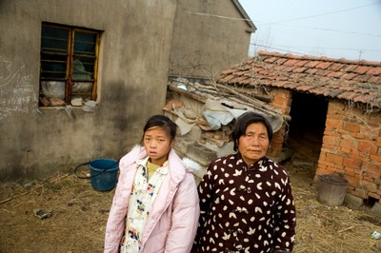
International Sex Trafficking
Where it begins
Global Poverty: Southeast Asia, Eastern Europe, former Soviet Union
Notes:
We work together because this is the face of trafficking. Trafficking begins with terrible poverty, usually in Southeast Asia, Eastern Europe, and the nations of the former Soviet Union, but it also happens in Latin America, Africa, and right here in America. It begins when family farms can no longer make ends meet, when wars ravage country-sides, when entire towns are abandoned in flights to the city.
Trafficking feeds on the most vulnerable.
This is a Chinese girl named Sun Lu, an orphan living in Jiangsu Province in China. Her father died of liver disease ten years ago, and her mother was purchased and forced to remarry by another family. She lives with her grandmother, who is in bad health (she’s got a failing back), and can’t provide economic or emotional support for the girl.
Sun Lu would be a prime target for a sex trafficking recruiter. And there are girls like Sun Lu in Thailand, Korea, Viet Nam, Moldova, Russia, Venezuela, Ghana, and right here in Georgia.
Find her story here: http://invision-images.com/archive/latest%20stories/young%20abandoned/INV-BRA-082/view?b_start=6

Slide 10
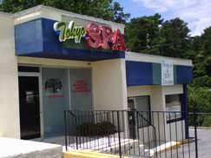
The International Trafficking Chain
Enforcers
johns
Notes:
So how does Sun Lu wind up trafficked into slavery in America? Let me take you through one scenario, though there are many. [I basically take a little while to go through this, going up to the screen and pointing at each arrow.]
Sun Lu and her family desperately need money. She sees an advertisement in the newspaper promising a paid trip to America to work as a waitress, as an entertainer, as a nanny.
America, for Sun Lu and many other poor women and children around the world, is still seen as a land of infinite opportunity--a place where your dreams will come true.
And so the promise of America means the world to someone like Sun Lu. It means a brand new world. For her: a new beginning.
Sometimes, instead of an advertisement, the recruiter will be a family relation, a friend—someone this girl and her family trusts. Sometimes it’ll be an older woman who speaks of the riches she made in America.
Can you imagine what these promises do to someone like Sun Lu? -- how easily she’d be drawn in? Here’s a way for her to help her grandmother. Here’s a way to fix the roof. To get food. Here’s a way for her to escape this poverty.
And so the recruiter then takes Sun Lu to get a passport, or goes to a document forger, and then to a travel agent to arrange a trip to America.
After she receives her documents, Sun will meet her first transporter—someone who will accompany her to the U.S.. [Here I interrupt and ask the audience this question:] Now, as a side note, guess how much a one-way ticket to China or Korea costs? I didn’t know myself, so I looked it up. [The answer? $1,000.] I can’t afford to take a trip like that. This is more money than Sun Lu has ever contemplated.
When she gets to America, she’ll meet another transporter, maybe a driver who will take her from Kennedy Airport or Hartfield to a spa in Macon or Valdosta.
Once she gets here, she’ll meet either the spa owner or the mamasan or madam. And then the nightmare begins.
She’ll be told: “I’ve paid for you to come here. You must now pay me back the money spent on all of the links in this trafficking chain: [point to each step]
your recruiter,
on the document forger,
on the travel agent,
on her transporter
on the ticket over for the two of them,
and on the transport from the airport to her spa.
The trafficker tells her, “you owe me $15,000-$25,000.” That’s the average that Asian women are told they owe when they come here. And Sun Lu won’t know the number’s inflated.
And then her owner confiscates her passport until she pays off her debt.
Sun Lu is now a prisoner.
That’s trafficking. That’s modern day slavery.
Her owner tells her that she will room and board at the spa, and she’ll have to pay exorbitant rates for that too. That’ll be added to her debt.
She’ll pay for health care,
she’ll pay for legal services,
she’ll pay for advertising (all those billboards cost a lot of money),
she’ll pay for taxes, all at extremely high rates.
She will find herself buried alive under an ever-growing mountain of debt. And she will never pay this debt off until her owner is finished with her. . . Until her body is no longer a money-maker.
She will be prevented from escaping by enforcers (Point to the screen, bring them back to the diagram)—men who are paid to stand guard at the doors of these brothels. She will not be able to go anywhere without them, and often she won’t leave the spa at all.
And she’ll be charged for the guards’ salaries, and this will add to her debt.
She is controlled in every way.
She has no way to escape. She has no freedom. No country. No community. No church. No home.
And she’s brutalized every day.
And she’s terrified.
And we drive by her on the highway. And we say nothing.
Now how will we be judged for that? And how will we judge ourselves?

Slide 11
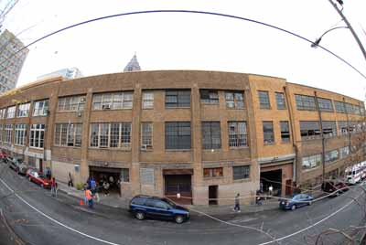
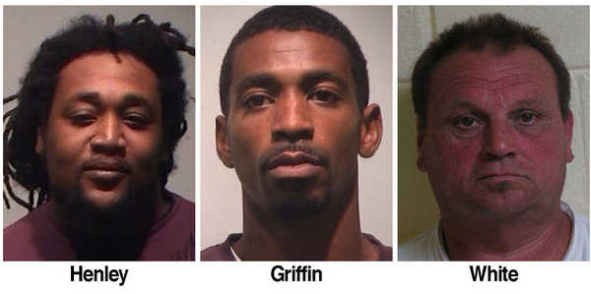
The Domestic Trafficking Chain
Notes:
Domestic trafficking resembles a shorter version of this diagram. Usually in domestic trafficking, the girl would be a “throwaway”—not a runaway—a throwaway:
someone whose parents have abused her, perhaps sexually,
someone who might also come from a poor family, a family who rejects her,
someone who runs to an Atlanta homeless shelter, where she’s almost immediately approached by a sweet-talking man.
Maybe he promises to be her boyfriend, promises to marry her, believes in her, says he sees something in her that nobody else has.
Again, like Sun Lu, this vulnerable little girl will be promised a new beginning, a new life.
If you are a homeless girl in Atlanta, you will be approached by a pimp within 48 hours. This is a fact. The pimps cluster around shelters like vultures. And this girl, who is looking for someone to trust, and looking for self-confidence, gets drawn by traffickers into the under-ground world of sex slavery.

Slide 12
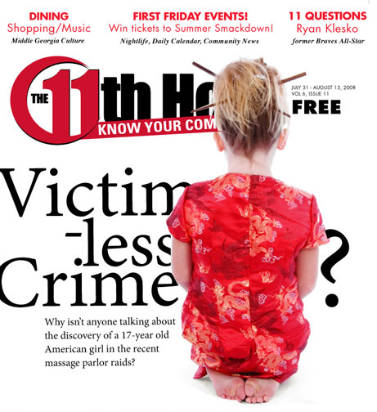
Child Exploitation Victim Services
Notes:
Thank you, first of all, for having me here, thanks for coming out, and [insert name of group’s leader here] thanks for inviting me.

Slide 13
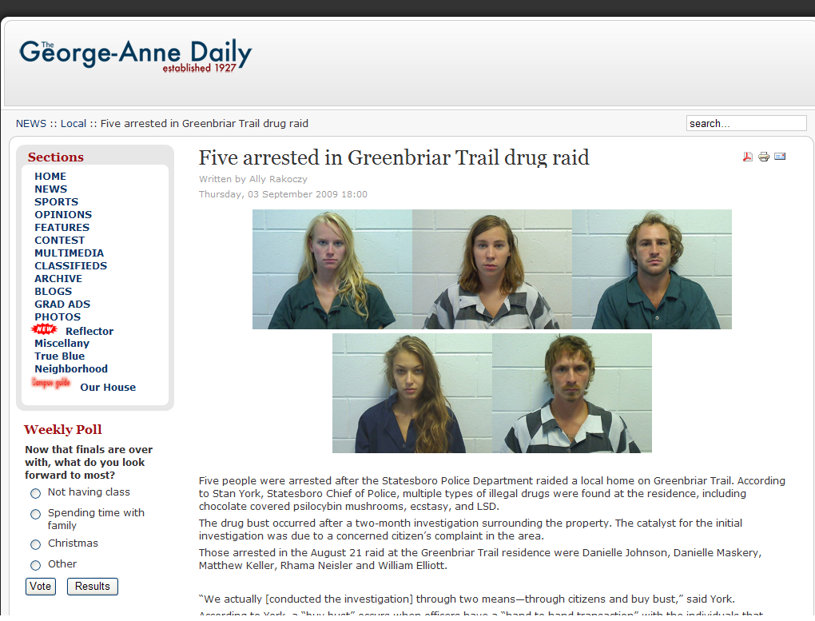
Child Exploitation Victim Services
Notes:
Thank you, first of all, for having me here, thanks for coming out, and [insert name of group’s leader here] thanks for inviting me.

Slide 14
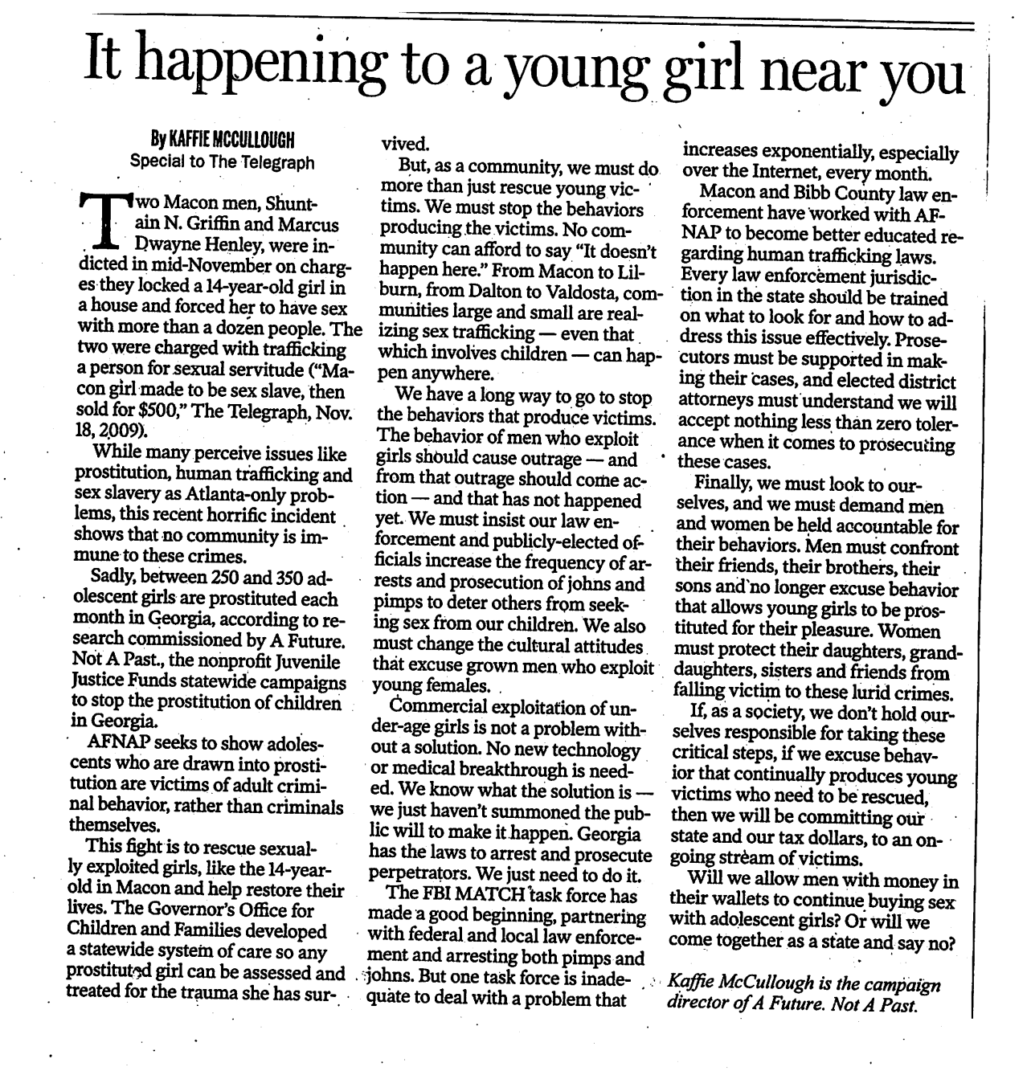
Child Exploitation Victim Services: successful advocacy
INSERT PHOTO-SCAN OF KAFFIE’S MACON TELEGRAPH EDITORIAL HERE – illustrate success story of getting a victim the vital help she needs. (Then transition to new sites for CSEC in Middle-Georgia)
Notes:
Thank you, first of all, for having me here, thanks for coming out, and [insert name of group’s leader here] thanks for inviting me.

Slide 15
Trafficking on Craig’s List
Notes:
Domestic trafficking resembles a shorter version of this diagram. Usually in domestic trafficking, the girl would be a “throwaway”—not a runaway—a throwaway:
someone whose parents have abused her, perhaps sexually,
someone who might also come from a poor family, a family who rejects her,
someone who runs to an Atlanta homeless shelter, where she’s almost immediately approached by a sweet-talking man.
Maybe he promises to be her boyfriend, promises to marry her, believes in her, says he sees something in her that nobody else has.
Again, like Sun Lu, this vulnerable little girl will be promised a new beginning, a new life.
If you are a homeless girl in Atlanta, you will be approached by a pimp within 48 hours. This is a fact. The pimps cluster around shelters like vultures. And this girl, who is looking for someone to trust, and looking for self-confidence, gets drawn by traffickers into the under-ground world of sex slavery.

Slide 16
Domestic Trafficking Demographics
Female
Caucasion/African-American
12-16 Years Old
Single Parent (mother)
Low Income
Notes:
Domestic trafficking resembles a shorter version of this diagram. Usually in domestic trafficking, the girl would be a “throwaway”—not a runaway—a throwaway:
someone whose parents have abused her, perhaps sexually,
someone who might also come from a poor family, a family who rejects her,
someone who runs to an Atlanta homeless shelter, where she’s almost immediately approached by a sweet-talking man.
Maybe he promises to be her boyfriend, promises to marry her, believes in her, says he sees something in her that nobody else has.
Again, like Sun Lu, this vulnerable little girl will be promised a new beginning, a new life.
If you are a homeless girl in Atlanta, you will be approached by a pimp within 48 hours. This is a fact. The pimps cluster around shelters like vultures. And this girl, who is looking for someone to trust, and looking for self-confidence, gets drawn by traffickers into the under-ground world of sex slavery.

Slide 17
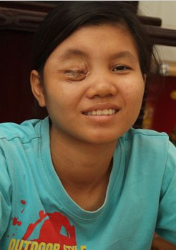
Mechanisms of Control
Confinement, isolation
Debt bondage
Threats, Violence, Shame
Psychological manipulation
Drugs, alcohol
“We worked six days a week and twelve-hour days. We mostly had to serve 32-35 clients a day. Weekends were worse. Our bodies were utterly sore and swollen. The bosses did not care. We worked no matter what.”
- Maria, trafficking survivor
Notes:
Once in the spa or hotel room or apartment, the victim will be confined there, isolated from any real contact with the outside world. She may be routinely uprooted and transferred to other spas in a national network that will move her from city to city, town to town.
The scenery will change, but the threats will remain the same.
Her traffickers might threaten to kill her relatives if she leaves them. They tell her: “we know where your relatives live.”
They might say, “we’ll tell your relatives back home—your whole town—what you’re doing in America, that you’re a whore.” In a culture of shame, this can be a death sentence.
If she’s internationally trafficked, they’ll tell her “Americans hate immigrants, the police hate immigrants. If the police catch you they’ll lock you up for life.”
Mostly they tell her that this is a good place to be, all things considered.
If she resists at first, she will be forcibly raped. Sometimes girls are raped scores of time in one evening to break them down, to make them accept their situation.
If she continues to resist, she will be threatened, she will be verbally abused,
she will be physically hurt,
she may be killed.
After she’s broken, the brainwashing begins—the psychological control.
She will be encouraged to see her “Mamasan” or madam as a stern but caring mother, her fellow trafficking victims as “sisters,” her transporters are “uncles,” and her kitchen maid “Auntie.”
The traffickers will convince her that this is her new family—the only people she can count on in this strange country.
They’ll convince her that what is happening to her is just, that it’s right, that it’s the way things should be.
She will work from 8 in the morning to 2 in the morning, and she won’t see this as trafficking—she isn’t read up on the TVPA Act or UN Human Rights Declaration—nobody’s shown her a Powerpoint presentation on trafficking—she’s never even heard the word! She’s encouraged to see this as normal, to see sleeping on a dirty mattress of a small room with ten other women as normal, to see her continual rape as normal.
She will be convinced that if she just sticks it out, one day the American dream will still be hers.
And even if she resists, even if she knows that what’s being done to her every day is wrong, she’ll still stay quiet.
After all, nobody else seems to care about her. Nobody wants to know her story.

Slide 18
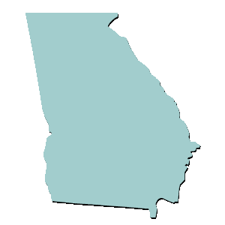
International Sex Trafficking in GA
Atlanta: National Human Trafficking Hub
1999: Vietnamese prostitution ring: 1,000 women and children trafficked into U.S., as young as 13.
2008: Of 100 spa-workers, “none knew they would be prostitutes. . . they’re not allowed to leave the spa– there’s no freedom whatsoever.”
Clayton County: Spa Raids Reveal Sex Slavery
2007: One third of the spas were “definitely holding women against their will” according to the Sheriff Victor Hill.
“One woman said she had been held for four years - even tried to escape and was unsuccessful but was assaulted for trying to escape.”
Macon: “Asian Massage Parlor Paradise”
Notes:
In Clayton county, just up the road from us, the police raided 14 spas, nearly a third of which were “definitely holding women against their will.” [Read “One woman said she had been. . .]
In the past few years, Mayor Franklin and the Atlanta police have gotten serious about trafficking. That’s why they called Alia and Tapestri.
Clayton County has gotten serious about trafficking, closing down 14 of their spas.
And as they crack down hard on sex trafficking, where do you think the traffickers go? [I wait for the answer. And then I repeat what they say.] They go to less hostile territory.
Ten years ago there were two or three spas in Macon. Last May, Macon, Georgia was home to about 25 Asian Massage Parlors. This is a city of less than 100,000. 25 spas.
Just to put this in context, San Francisco—SAN FRANCISCO! A city of millions—has 99 spas. [per capita male] What is going on here in Macon, Georgia?
Why has Macon, in the words of one john, become the “Asian Massage Parlor paradise”?
The answer simple: nobody cares. We’ve created the perfect environment for trafficking and prostitution in the heart of Georgia.
Now it may be that we have the most humane brothels in the world in Macon, Georgia.
But if our 25 spas are anything like the Asian spas in Atlanta, Clayton County, Los Angeles, San Francisco, and New York, then it’s likely that trafficking going on here, within miles of where we sit right now.
And this is where our organization, S.T.O.P., comes into the picture. . .

Slide 20
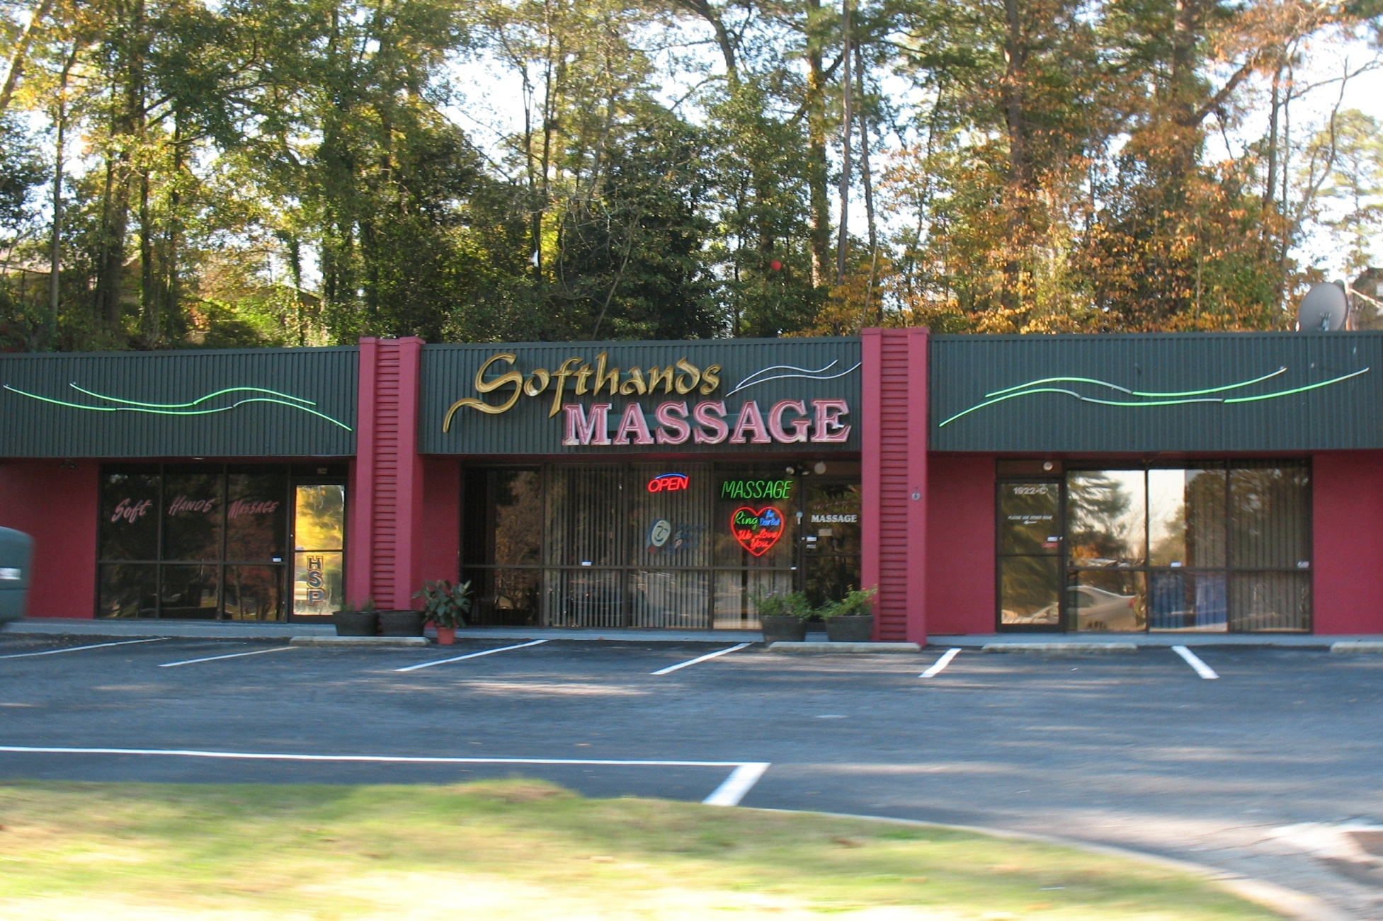
“Asian Massage Parlor Paradise”
Notes:
Thank you, first of all, for having me here, thanks for coming out, and [insert name of group’s leader here] thanks for inviting me.

Slide 21
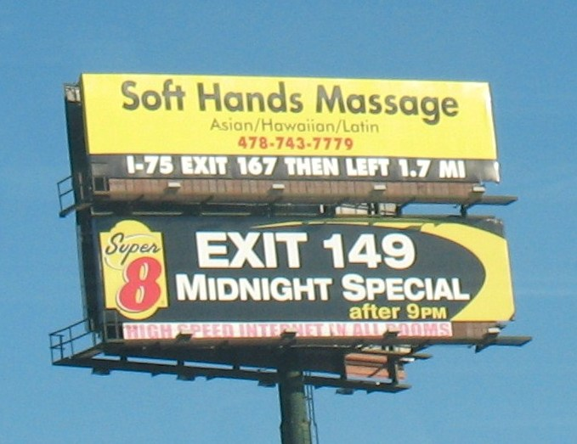
“Asian Massage Parlor Paradise”
Notes:
Thank you, first of all, for having me here, thanks for coming out, and [insert name of group’s leader here] thanks for inviting me.

Slide 22
Take Back the Sky
Email/Letter Writing/Phone Call Campaign
Posted 5 Billboard Company names and
addresses advertising along Rt 75.
Two Companies have stopped selling to Spas
Two Companies have not renewed contracts
One will consider it after reviewing legal issues
THEN WE PUT UP OUR OWN BILLBOARDS

Slide 25
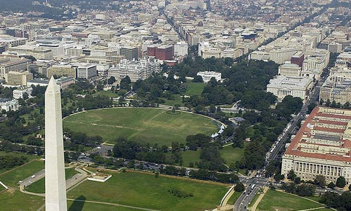
Per Capita Sex Spas
#spas per capita city comparative
20 1 in 4,639 Macon
7 1 in 81,714 Washington D.C. 18 x
Notes:
1,434 massage spas

Slide 26
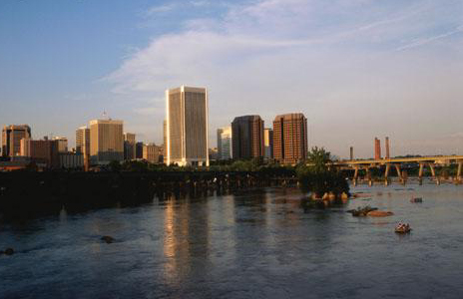
Per Capita Sex Spas
#spas per capita city comparative
20 1 in 4,639 Macon
7 1 in 81,714 Washington D.C. 18 x
19 1 in 75,543 Northern Virginia 16 x
Alexandria
Arlington
Falls Church
Annandale
Fairfax
1,435,329
Notes:
1,434 massage spas

Slide 27
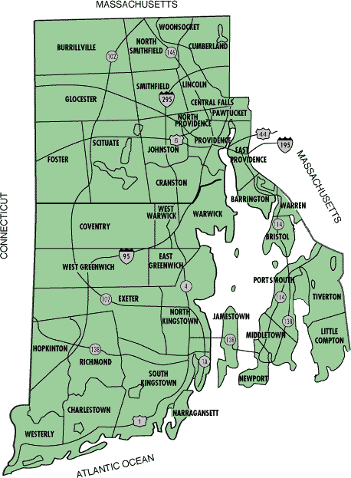
Per Capita Sex Spas
#spas per capita city comparative
20 1 in 4,639 Macon
7 1 in 81,714 Washington D.C. 18 x
19 1 in 75,543 Northern Virginia 16 x
1 in 31,818 Rhode Island 7 x
Notes:
1,434 massage spas

Slide 28
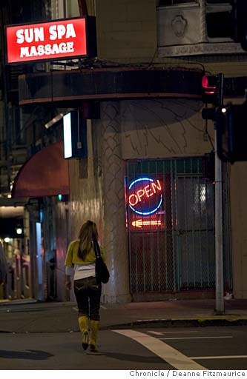
Per Capita Sex Spas
#spas per capita city comparative
20 1 in 4,639 Macon
7 1 in 81,714 Washington D.C. 18 x
19 1 in 75,543 Northern Virginia 16 x
1 in 31,818 Rhode Island 7 x
99 1 in 8,161 San Francisco 1.75x
Notes:
1,434 massage spas

Slide 29
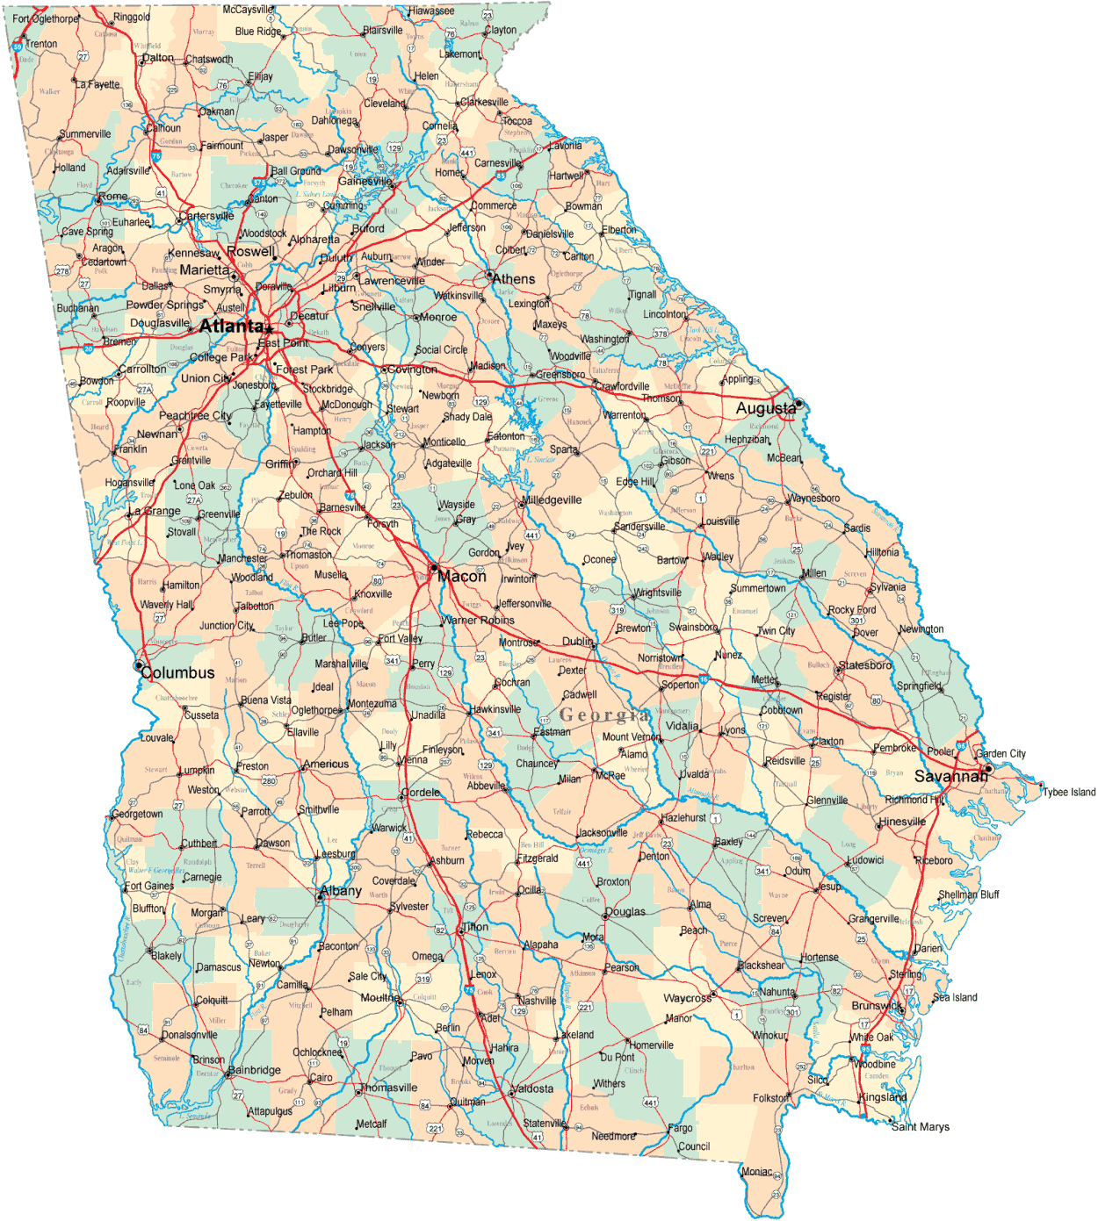
Local Massage Ordinances
Notes:
Thank you, first of all, for having me here, thanks for coming out, and [insert name of group’s leader here] thanks for inviting me.

Slide 30
Local Massage Ordinances
Centerville
Notes:
Thank you, first of all, for having me here, thanks for coming out, and [insert name of group’s leader here] thanks for inviting me.

Slide 31
Local Massage Ordinances
Centerville
Byron
Warner Robins
Notes:
Thank you, first of all, for having me here, thanks for coming out, and [insert name of group’s leader here] thanks for inviting me.

Slide 32
Local Massage Ordinances
Athens
Atlanta
Augusta
Centerville
Byron
Warner Robins
Savannah
Columbus
Notes:
Thank you, first of all, for having me here, thanks for coming out, and [insert name of group’s leader here] thanks for inviting me.

Slide 33
Local Massage Ordinances (55 cities and counties)
Alpharetta
Athens
Atlanta
Augusta
Banks Co.
Bartow Co.
Brunswick
Byron
Canton
Cedartown
Centerville
Chamblee
Cherokee Co.
Clarkston
Clayton Co.
Cobb Co.
College Park
Columbia Co.
Columbus
Dekalb Co.
Doraville
Duluth
Flemington
Holly Springs
Johns Creek
Kennesaw
Lilburn
Loganville
Marietta
Morrow
Norcross
Palmetto
Ringgold
Riverdale
Rockland Co.
Roswell
Sandy Springs
Savannah
Smyrna
Snelville
Statesboro
Stockbridge
Suwanee
Union City
Warner Robins
Winder
Forest Park Garden City Gwinnett Co. Hall Co.
Notes:
Thank you, first of all, for having me here, thanks for coming out, and [insert name of group’s leader here] thanks for inviting me.

Slide 34
Local Licensing of Massage as Adult Entertainment (67 cities and counties)
Notes:
Thank you, first of all, for having me here, thanks for coming out, and [insert name of group’s leader here] thanks for inviting me.

Slide 35
Local Licensing of Massage as Adult Entertainment (67 cities and counties)
Albany
Americus Ashburn
Avondale Estates Bainbridge Baldwin County Barrow County Bleckley County Bulloch County Cartersville Catoosa County Colquitt County Commerce Cornelia
Dalton
Dougherty Co.
Echols County Emanuel County Forsythe County Gilmer County Grayson
Harralson Co. Harris Co.
Hart Co.
Helen
Hinesville
Houston County, Jasper
Jefferson
Jesup
Jonesboro
McDuffie
Monroe
Montecello
Morgan County Moultrie
Murray County Newnan
Oconee County Oakwood
Paulding County Peachtree City Peach County Pickens County Powder Springs Rincon, Rome Screven County Spalding County
St. Marys
Stone Mountain Sylvester
Sylvania
Thomson
Tifton
Union County
Ware County Washington Whitfield County
Kingsland, Lee Co., Lincoln Co., Madison, McDonough, Metter
Notes:
Thank you, first of all, for having me here, thanks for coming out, and [insert name of group’s leader here] thanks for inviting me.

Slide 36
Georgia’s One Major City with No Massage Ordinance
Notes:
Thank you, first of all, for having me here, thanks for coming out, and [insert name of group’s leader here] thanks for inviting me.

Slide 37
Georgia’s One Major City with No Massage Ordinance
Notes:
Thank you, first of all, for having me here, thanks for coming out, and [insert name of group’s leader here] thanks for inviting me.

Slide 38
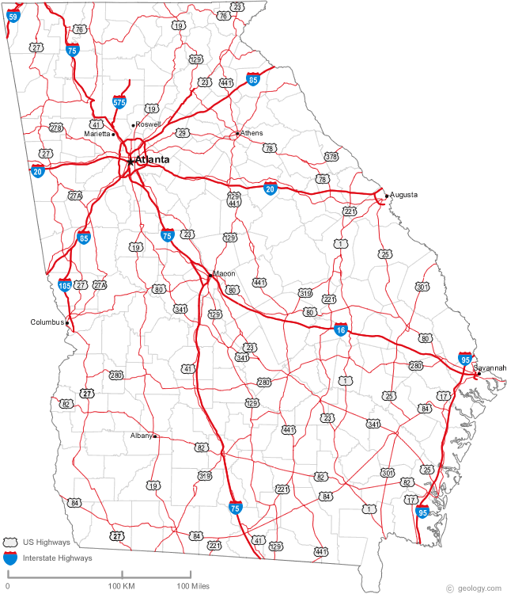
Highway View
Notes:
Thank you, first of all, for having me here, thanks for coming out, and [insert name of group’s leader here] thanks for inviting me.

Slide 39
The Start of a New Ordinance
Researched ordinances in other cities and counties
With legal help drafted a new ordinance
Brought to City Attorney
City Attorney refused to release the ordinance for discussion or vote
Met with 8 members of City council individually
Met with Secretary of State
Met with States Attorney
Met with County commissioners
Met with Senator Cecil Staton
Talked to anyone who would listen

Slide 40
The State Law
O.C.G.A. § 43-24A
Not covered by O.C.G.A. § 43-24A
“Licensed Massage Therapists”
Strict Licensing and Penalties
Only State Can Revoke Licenses of Individual Therapists
“Massage Therapy” TM
Business Establishment Licensing
Non-therapeutic Massage
Body Scrubs
Body Manipulation
Sauna Work
Spa Work
Asian Massage
“This chapter shall not be construed to prohibit a county or municipality from enacting any regulation of persons not licensed pursuant to this chapter.”

Slide 41
Business Licensing Saves Macon Money
Regulatory Device
Police raid
Inspection
Deterrence
Police raid
Police raid
Revocation
Police raid
Police raid
$$$$$$$$$
$
$
Criminal Activity Continues
Notes:
Thank you, first of all, for having me here, thanks for coming out, and [insert name of group’s leader here] thanks for inviting me.

Slide 42
The Life of An Ordinance
March 17th an amendment to allow cities to adopt their own ordinances passes in the
State House unanimously
City Council Vote set for
April 5th and 6th
May 2010 City Ordinance Passed
AUGUST 2008-MAY 2010

Slide 43
News Media Attention
Three Radio shows
Four TV spots
15 articles or editorials in
The Macon Telegraph

Slide 44
What can I do?
Know the signs of human trafficking
Join Middle Georgia ALERT (www.mgalert.org)
Stay informed of legislative action
Advocate: write mayor, council members, commissioners, newspaper
Question “victimless crime” culture
Give this presentation at your church or civic club, or ask us to present
Notes:
Human trafficking is beyond “big business.” It is mammoth business. It’s the second largest form of international crime after drugs, but before arms. And it’s the fastest growing form of international crime, period.
These statistics concern human trafficking, not just sex trafficking, though sex trafficking makes up the majority of human trafficking cases world-wide.
This is a business that hauls in $32-$47 billion a year. More than Coca-Cola and Starbucks. . . combined.
And the reason it’s enormously profitable because it uses a largely unpaid, disposable workforce.
There are millions of people trafficked internationally every year (1 million annually in sex trafficking alone). The U.S. State Department estimates that half a million CHILDREN are trafficked into the sex trade every single year. In America the State Department estimates that 17,500 are trafficked into the United States every year. It might well be more. And this number doesn’t include domestic trafficking victims.
[Read Condaleeza Rice’s quote]
I really want to stress this. George W. Bush sees human trafficking as modern-day slavery, and Barack Obama does; John McCain does and Hillary Clinton does. Conservatives, liberals, and everyone in between form common cause around this issue.

Slide 45
The Power of Prayer
Interfaith Alliance of Macon: IAM
The Last Shall be First:
End Modern Day Slavery In Georgia
Meet You at 3:00
Drive By Praying
Use Psalm Reflections Guides
Bless These Hands Fair Trade Festival

Slide 46
www.mgalert.org
Notes:
Thank you, first of all, for having me here, thanks for coming out, and [insert name of group’s leader here] thanks for inviting me.

