Slide 1
What is Vincentian Spirituality?

Slide 2
What is Vincentian Spirituality?
Vincentians seek…
through prayer
meditation on the scriptures
the teaching of the Church
through their daily lives
in their relationship with those in need
…to bear witness to the love of Christ.
Inward-outward movement of the Spirit
Inward – Inspiration, Prayer, Growth in our Vincentian Virtues
Outward – Reaching Out, Meeting the Needs of Others
“No Work of Charity Is Foreign To The Society”

Slide 3
Essential Parts of Vincentian Spirituality
Divine Providence
Grounded in Sacred Scripture
Prayer and Meditation
Zeal, Passion
Simplicity, Gentleness
Humility, Selflessness
Charity and Justice
“The Poor are Our Masters”
“No Work of Charity Is Foreign To The Society”

Slide 4
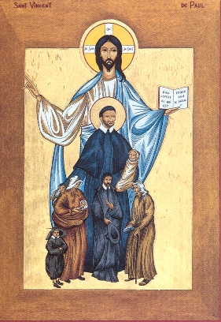
Divine Providence
Trust In and Reliance On Divine Providence
Frederic Trusted That God Was Providing for Him
Frederic Believed That God Was Acting in His Life and the Lives of Others
Frederic’s Words:
“Our Little Society Has Grown Large Enough To Be A Providential Fact”
“No Work of Charity Is Foreign To The Society”

Slide 5
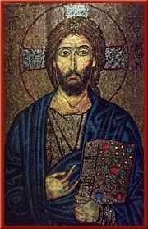
Call to Holiness
Vincentians Should be Grounded in Sacred Scripture
Jesus Reading from the Scroll and Announcing Fulfillment of the Scriptures (Luke 4:16-21)
Preferential Option of the Poor in the Beatitudes (John 12:8 and Matthew 5:2-11)
Whatever You do for the Least of My Brothers and Sisters, You did it for Me (Matthew 25:36-46)
You will not be Judged. By this Everyone will know that You are My Disciples, if You have Love for One Another (Luke 6:32-37)
Love One Another (Luke 10:25-28; John 13:34-35; 2 Cor:14)
“No Work of Charity Is Foreign To The Society”

Slide 6
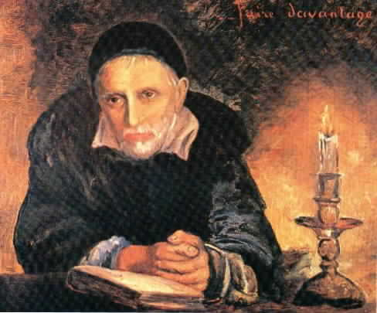
Prayer
Prayer is Essential to Being a Vincentian
Open and Close All Meetings with a Prayer
Pray Before a Home Visit
Pray with Those We Serve
Pray to Sustain Us in Our Daily Vincentian Activities
“No Work of Charity Is Foreign To The Society”

Slide 7
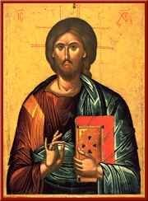
Vincentian Virtues
Simplicity
Frankness
Integrity
Genuineness
Humility
Accepting the Truth of Our Frailties, Gifts, Talents, and Charism Knowing that All that God Gives Us is for Others and that We Achieve Nothing of Eternal Value Without His Grace
Selflessness
Dying to Our Ego with a Life of Self-Sacrifice
Members Share Their Time, Their Possessions, Their Talents and Themselves in a Spirit of Generosity
Gentleness
Friendly Assurance and Invincible Goodwill, Which Means Kindness, Sweetness, and Patience in Our Relationship with Others
Zeal
A Passion for the Full Flourishing and Eternal Happiness of Every Person
“No Work of Charity Is Foreign To The Society”

Slide 8
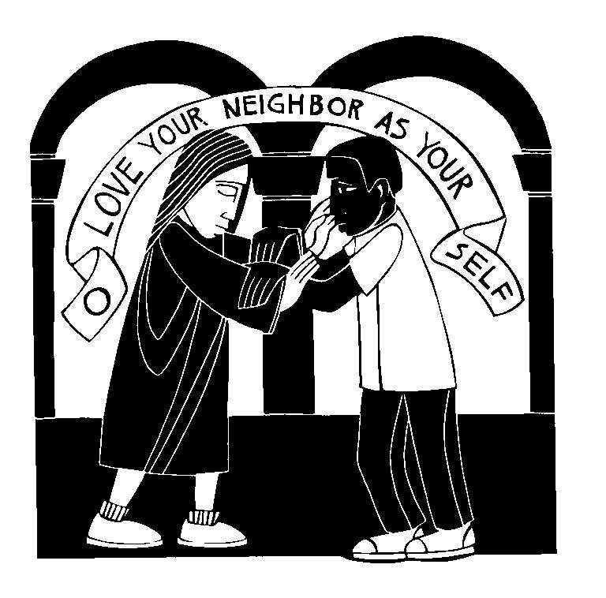
Good Samaritan Luke 10:29-37
Frederic saw Vincentians not as Good Samaritans But as “Weak Samaritans… Let us dare…to approach this great sick one. Perhaps he will not be frightened of us.”
St. Vincent “The poor are your masters, you will see the face of Christ in the poor. It is for your love alone that the poor will forgive you the bread you give them.”
“Faith without good works is dead.”
“Let Us Go To The Poor.”
“No Work of Charity Is Foreign To The Society”

Slide 9
Charity and Justice
Be mindful of our human limitations, and allocate resources as wisely as we can with God’s help
St. Vincent’s Words:
“There is No Charity that is Not Accompanied by Justice, Nor Does it Permit Us to Do More Than We Reasonably Can.”
Frederic’s Words:
“The Order of Society is Based on Two Virtues: Justice and Charity…”
“No Work of Charity Is Foreign To The Society”

Slide 10
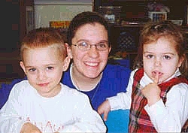
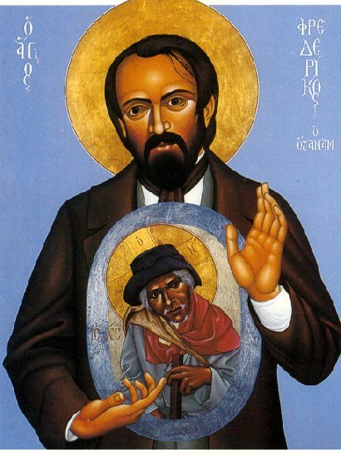
Advantages of Lay Spirituality
The laity live in the world…they live in ordinary conditions of life in the family and in society, from which the web of their existence is woven.
Bl. Frederic thought that wounded humanity would be initially more receptive of Vincentian lay persons approaching them rather than clergy or religious.
“No Work of Charity Is Foreign To The Society”

Slide 11
Summary
What is Vincentian Spirituality
Inner Life – Prayer and Meditation
Outward Life – Bearing witness to the life of Christ by meeting the needs of others
Divine Providence
Grounded in Sacred Scripture
Prayer Is Essential
Vincentian Virtues
Simplicity, Humility, Selflessness, Gentleness, Zeal
“Weak Samaritans” – The Poor are Our Masters
Charity and Justice – what we can reasonably do
Lay Spirituality
Ordinary people, out in the world
“No Work of Charity Is Foreign To The Society”

