Slide 1
Systemic Change and the Poor
A Contemporary Call

Slide 2
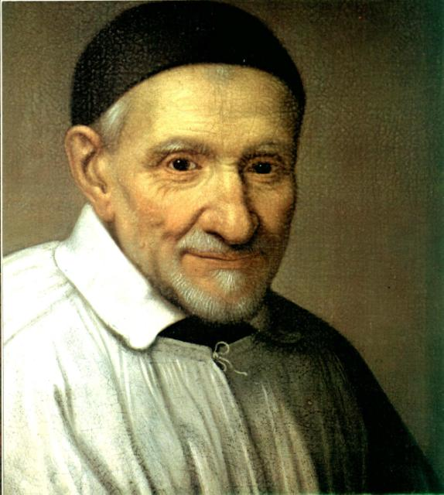
Three steps:
Some background
The notion of systemic change
Akamasoa – a systemic change project in Madagascar

Slide 3
I. Background
The naming of a Commission for Promoting Systemic Change and its mandate
To help bring about systemic change through the labors of those serving among the oppressed poor.

Slide 4
The members of the Commission:
Fr. Joseph Foley, C.M.
Mrs. Patricia Nava, AIC
Rosamaría Casas (translator)
Sr. Ellen Flynn, D.C.
Fr. Robert Maloney, C.M.
Rev. Mr Gene Smith, SSVP
Fr. Norberto Carcellar, C.M.
Fr. Pedro Opeka, C.M.

Slide 5
The Goals of the Commission for Promoting Systemic Change
To study available material concerning Systemic Change
To discuss their own involvement in Systemic Change
To formulate a series of effective strategies which would subsequently be shared with the members of the Vincentian Family
To propose how the effective strategies might be best disseminated

Slide 6
Methodology of the Commission for Promoting Systemic Change
At the beginning of the process, each of the members wrote a story, based on his or her own experience of systemic change.
In each one of the stories, we identified strategies that were effective for bringing systemic change about.

Slide 7
Methodology of the Commission for Promoting Systemic Change
We quickly saw the importance of self-sustaining programs, so that the poor themselves would be active participants from the beginning to the end.
We emphasized the spirituality that lies behind a systemic change approach.

Slide 8
What We Have Done So Far
A book: Its title is Seeds of Hope: Stories of Systemic Change
A tool kit
The Famvin website
Start-up grants
6 continental workshops
Mexico - February 2009
Brazil - June 2009
Cameroon - July 2009
Bangkok - November 2009
USA - November 2010
Europe – dates for 3 workshops to be fixed in 2011

Slide 9
Book contents
Prologue
Akamasoa, a Community of Good Friends
I Have a DREAM
Mission-Oriented Strategies
The Perfect Storm
AIC Madagascar, a Story of Systemic Change within an Association
Person-Oriented Strategies
The Story of the Passage
The Homeless Peoples’ Federation of the Philippines
Task-Oriented Strategies
The Clancy Nightshelter
The Mindoro Project in the Philippines
Strategies Directed Toward Co-Responsibility, Networking and Political Action
The Vincentian Mission at the United Nations
Epilogue

Slide 10
II. The Notion of Systemic Change

Slide 11
The Basic Idea
A system is a whole, a unified composite of things that work together
Today scientists focus continually on systems
A star
The body
Society
Systemic Change thinking affirms that “everything is connected to everything else.”

Slide 12
An Illustration of how Systemic Change works
Job
Education
Money
Health
Food

Slide 13
Criteria of Systemic Change Projects
Wide-ranging social impact on the life of the poor person
Sustainability
Replicability
Innovation

Slide 14
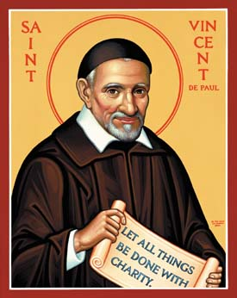
An important, fundamental distinction:
Immediate assistance to the poor and systemic change projects are:
not either/or options
but both/and imperatives

Slide 15
Systemic Change and the Poor
A Contemporary Call

