Slide 1
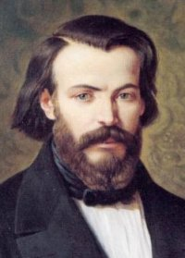
FREDERIC OZANAM
200th
anniversary
of his birth
A COMMITTED LAYMAN

Slide 2
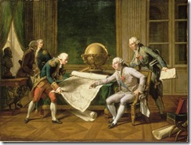
Frederic’s adult activity encompassed a short period of time: 1822-1852.

Slide 3
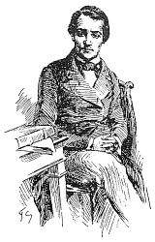
1822
He studied at the Royal College in Lyons and even though he felt more attracted to the study of history than law, he oriented his studies toward law because he did not want to disobey his father who had a great influence on him.

Slide 4
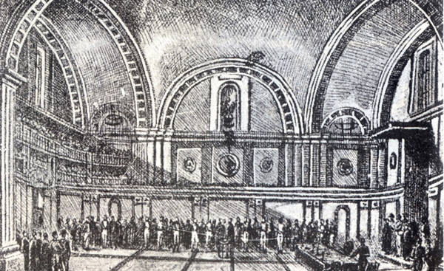
1831
He moved to Paris where he studied Law and Letters.
There he met the wise Ampere, who became a father figure.

Slide 5
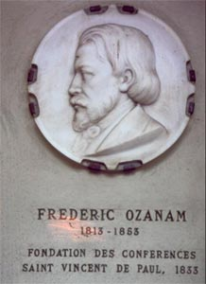
1833
As a result of his concern for the social aspect and for making his faith effective, he established with other students (especially Bailly) the Confraternity of Charity

Slide 6
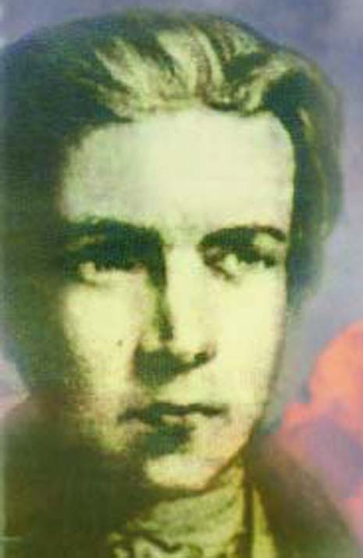
1834, 1836 – 1839
He studied and obtained his degree in law and letters.

Slide 7
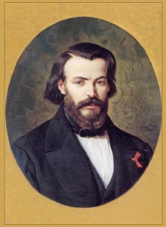
1836
He opened a small law office in Lyons,
but this lasted for a very brief period of time

Slide 8
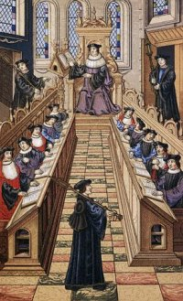
1839
He became a professor of
Commercial Law

Slide 9
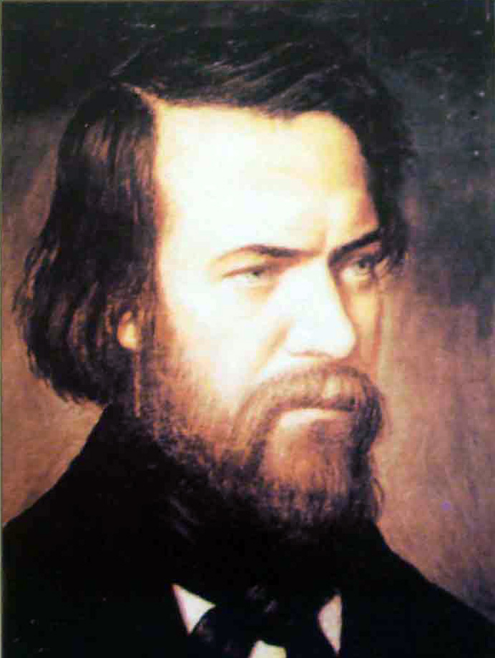
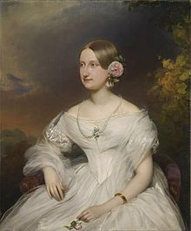
1841
In the month of June he married Amelia Soulacroix.

Slide 10
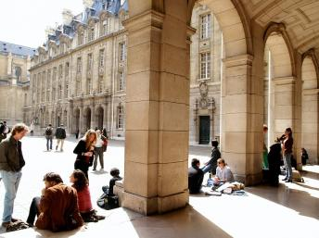
1841
He became a professor of literature at the Sorbonne and a tenured professor in 1844.

Slide 11
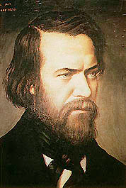
1846
Illness limited his ability to teach, but he spent much time traveling and writing.

Slide 12
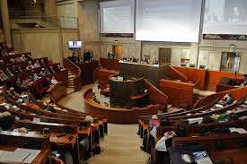
1848
He became a candidate for the National Assembly.

Slide 13
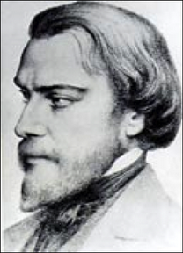
1852
Because of his health he retired from his teaching position at the Sorbonne.

Slide 14
As we can see, he engaged in many various activities that revolved around the law: studies, teaching, writing, and action on behalf of the poor.

