Slide 1
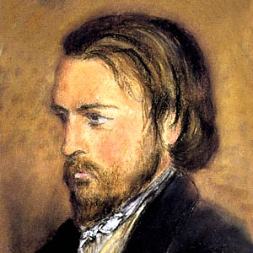
Ozanam and the Conferences of Saint Vincent de Paul
Fr. Mario Yépez Barrientos CM

Slide 2
“His divine power has bestowed on us everything that makes for life and devotion, through the knowledge of him who called us by his own glory and power. Through these, he has bestowed on us the precious and very great promises, so that through them you may come to share in the divine nature, after escaping from the corruption that is in the world because of evil desire. For this very reason, make every effort to supplement your faith with virtue, virtue with knowledge, knowledge with self-control, self-control with endurance, endurance with devotion, devotion with mutual affection, mutual affection with love…

Slide 3
…If these are yours and increase in abundance, they will keep you from being idle or unfruitful in the knowledge of our Lord Jesus Christ. Those who lack them are blind and shortsighted, forgetful of the cleansing of their past sins. Therefore, brothers and sisters, be all the more eager to make your call and election firm, for, in doing so you will never stumble. For, in this way, entry into the eternal kingdom of our Lord and savior Jesus Christ will be richly provided for you.”
(2 Peter 1:3-11)

Slide 4
1. Context with regard to the life of Frederic Ozanam (1813-1853)
A “revolutionary” atmosphere: influence of the French Revolution of 1789 (monarchy and the republic).
The industrial revolution: new forms of poverty during the XIX century.
Conflict between atheism and Christianity --- a struggle of ideas.

Slide 5
2. How did the Conferences of Charity come into existence?
In 1831 Ozanam arrived in Paris and was disturbed by the situation that he encountered there.
Zealous to help young people who, like him, felt uprooted from their families, he thought of gathering them together in an association. Frederic was able to maintain strong relationships with his friends.
In one of his letters he stated: I want to form a group of friends who will work together in the field of science but do this guided by Catholic thinking.

Slide 6
Conference of Law and History. Ozanam, together with E. Bailly (director of the newspaper The Catholic Tribune) was an active participant in these meetings. Bailly offered his offices as a meeting place.
With regard to these meetings Ozanam stated: we are able to show other students that it is possible to be Catholic and have common sense, to love religion and liberty.

Slide 7
Motivation: the challenge that a young anti-Christian student extended during one of the meetings of the Conference of History: “In former times Christianity did some wonderful things, but at the present time it is dead. You, you who are so proud in being Catholic, what do you do? Where are your works, the works that prove your faith and that would impel others to become Christian?

Slide 8
Reaction: Ozanam, together with some other young men, decided to form a group in which action (charity) would become an expression of their beliefs. It was proposed that E. Bailly would guide and lead the group. Bailly also offered the offices of his newspaper as a meeting place
Birth: The Conference of Charity was formed on April 23, 1833. Present were: Bailly (42), Lamache (23), Clave, Le Taillandier, Devaux, Lallier y Ozanam (22), De la Noue (22?).

Slide 9
At the inauguration of a group of the Society in Florence, Ozanam stated: “You see before you one of those eight students who twenty years ago, in May of 1833, gathered together for the first time in the capital of France and under the protection of Saint Vincent de Paul … We felt the desire and the need to preserve our faith in the midst of various attacks from the different schools of false prophets. It was then that we said, ‘Let’s work! Let’s do something in conformity with our faith!’ To be true Catholics means we consecrate ourselves to that which is most pleasing to God. Let us aid our neighbor as Jesus Christ did, and let us place our faith under the protective wings of charity”.

Slide 10
E. Bailly became president and Devaux was treasurer. Even though Ozanam held no position of leadership he was a motivating force in the group. For this reason some have referred to him as: “Saint Peter hidden in the upper room”.

Slide 11
They decided to place the group under the patronage of St. Vincent de Paul and the Virgin Mary.
It seems that from a very early age Frederic has a great devotion to St. Vincent de Paul.
This devotion to St. Vincent was expressed in one of his letters: “My youthful days were preserved from many dangers as a result of my visit to the birthplace of Vincent de Paul”.

Slide 12
Vincentian Influence: E. Bailly had a brother who was a priest in the Congregation (he was the first spiritual advisor of the Society). Later they met Sister Rosalie Rendu, a Daughter of Charity, who worked in the Mouffetard area of Paris.
Her influence gave the Society a more charitable tone and thus made it less intellectual.

Slide 13
It is interesting to listen to Frederic’s understanding of the importance of a patron saint: “A patron saint is a model. It is necessary to make every effort to act and accomplish works like this; to take Jesus Christ as a model as he did. It is a life that is to be perpetuated. From his heart we seek encouragement and in his intelligence we seek light. He is a support and a protector in heaven to whom we owe a twofold veneration of imitation and invocation. Saint Vincent de Paul is to our advantage because of the proximity of the time in which he lived, because of the infinite variety of good works he inspired and because of his universal mission.

Slide 14
In this way Frederic and his companions (all of whom were intellectuals and concerned about defending their Christian faith) were able to give witness to their faith. They were at first encouraged in this by Sister Rosalie Rendu, DC and with the passing of time the members encouraged one another.

Slide 15
The Conferences of the St. Vincent de Paul Society
Quickly the number of members increased and even though after graduation many students returned to their home (outside of Paris), these young men brought with them the spirit of the Conference.
This reality led to the creation of a network of Conferences throughout France and would eventually lead to the spreading of the Society throughout Europe and the world.

Slide 16
Frederic expressed his fears to Emmanuel Bailly: “But do you not think that our charitable society itself in order to survive ought to make changes, and the spirit of intimacy on which it is built and the daily growth it should have can only be achieved by breaking up into groups which would have a common center and from time to time general assemblies? I am very rash to propose my young man’s ideas to you?”

Slide 17
This prophetic vision was sustained by the deep conviction that he was doing the will of God: “God had determined to form a large family of brothers who would spread out over the whole earth. Therefore we cannot call ourselves founders but rather it is God who has established us and who has desired that our association should come into existence”.

Slide 18
Frederic envisioned the establishment of a Society in which all could come together in the same spirit and become active in the lay Catholic apostolate.
Frederic highlighted the priority that should be given to the practice of fraternal charity in the Society because it is this charity that will preserve them in union with one another: “the strongest bond, which is the beginning of true friendship, is charity, and charity cannot exist without reaching out to others. It is like a fire that is extinguished if it is not fed … and its food is charity and good work … Therefore let us make every effort to reach out to others, even at the risk of rejection, … but let us reach out so that we can touch the greatest possible number of young people.

Slide 19
Frederic encouraged the writing of a Rule and formed a general council of which E. Bailly was invited to be president. General Assemblies were convoked on a regular basis and this provided an opportunity for the various groups to give a report on their activities. At the same time these assemblies were a time during which an annual report was written which was then sent to the different groups to enliven their faith, love and unity.

Slide 20
On December 31, 1835, in the midst of certain difficulties, especially the danger of division, Frederic’s proposal was accepted by everyone.
The Society would be placed under the patronage of St. Vincent de Paul and the Blessed Virgin; Bailly would become president; Ozanam, vice-president and Lallier, secretary.
The first four groups would take the name of the parish in which they were located: St. Philip of Roule, Our Lady of the Good News, Saint-Sulpice and Saint-Etienne-au-Mont (the seat of the Association).

Slide 21
As can be seen Frederic’s dream was becoming a reality: “I want to enclose the world in a network of charity”.
In the first Assembly Frederic stated: Here, at last, is the Association that we have longed for. Courage, then! Together or separated, near or far, let us love one another; let us love and serve the poor!”

Slide 22
The first Assembly was held on February 21, 1836 at which time the Rule was distributed to the members.
Name of the Association: Conference of Charity of Saint Vincent de Paul.
Motive to come together: To promote Christian piety, following Jesus, the doctrine of the church and the saints.
Patrons: Saint Vincent and the Blessed Mother.
Purpose: to provide spiritual and material relief to the neighbor who is in need.
Means: effective charity.

Slide 23
Ozanam visited Rome and had two audiences with Pope Pius IX who praised the work of the Society.
Expansion: 1842 Rome; 1843 Belgium, Scotland, Ireland; 1844 England; 1846 Germany, Greece, Turkey, United States, Mexico, the Lower Countries; 1847 Switzerland, Canada; 1850 Austria, Spain.
From its beginning the Society has practiced effective charity on behalf of those who are poor. The members are accompanied by a priest who serves as an advisor and who has knowledge about the life and work of Vincent de Paul and Frederic Ozanam.

Slide 24
For Ozanam and his companions, social action involved direct and personal contact with the poor (visits to their homes and dialogue and conversation which often led to many other forms of service).
As such social action had to be both spiritual and material; it also had to be personal and had to promote human integrity and human dignity. In this way the service that the society provided also had to benefit the members since these individuals ought to live an integral Christian life in which their spiritual life is developed in an on-going manner.

Slide 25
Today the St. Vincent de Paul Society functions in 130 countries, working in various manners with the same spirit of justice and charity as they serve the less fortunate members of society.
These members and collaborators are citizens from different social classes, but they work as volunteers on behalf of the community and especially on behalf of those who are poor.

Slide 26
Several Popes have recognized and praised the work of the St. Vincent de Paul Society (Pius IX, Leo XIII, Pius XII, John XXIII, Paul VI and John Paul II). They recommended that the Society continue its mission.
John Paul II surprised people in his homily during the beatification of August 22, 1997 when he shared the fact that as a student he had been a member of the Society.

Slide 27
Characteristics of the Society
Frederic Ozanam described the Society in the following manner: “A Catholic but lay society, humble but numerous, poor but overburdened by poor who seek consolation. A group that functions during an era in which charitable associations have a great mission to fulfill with regard to awakening the faith in order to sustain the church and eliminate the hatreds that divide people”.

Slide 28
The primary purposes of the Conferences of Charity are:
-To restore society to the guidance of Catholicism.
-To form an association of friends who are committed to work for such a restoration.
-To make a decision so that love/charity become the fundamental norm for life and thus through charity to attain holiness.
-Without explicitly stating this, the members (as simple, zealous, Christians … as a lay persons) should become involved in self-contemplation.

Slide 29
We can list the following characteristics:
-Trust in Divine Providence.
-Flexibility and the ability to adapt to distinct socio-economic situations.
-Catholic and lay, members sincere and self-sacrificing.
-Concerned about the effective practice of charity which is made evident in concrete works, dedicated to and persevering in the mission, openness, and an ability to utilize various forms, methods and means.

Slide 30
3. Some notes concerning the foundation of the St. Vincent de Paul Society
-A defined purpose
-A Society “of” and “for” young men
-Making charity effective
-Lay perspective: fraternity and love of the church, growth in personal holiness.

Slide 31
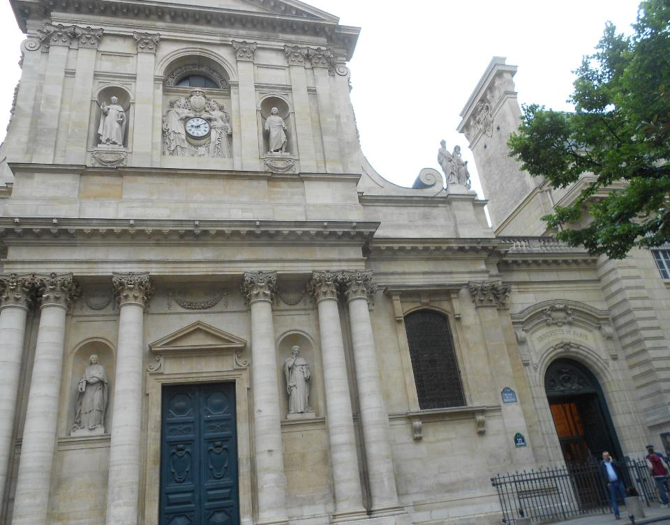
University
of Paris

Slide 32
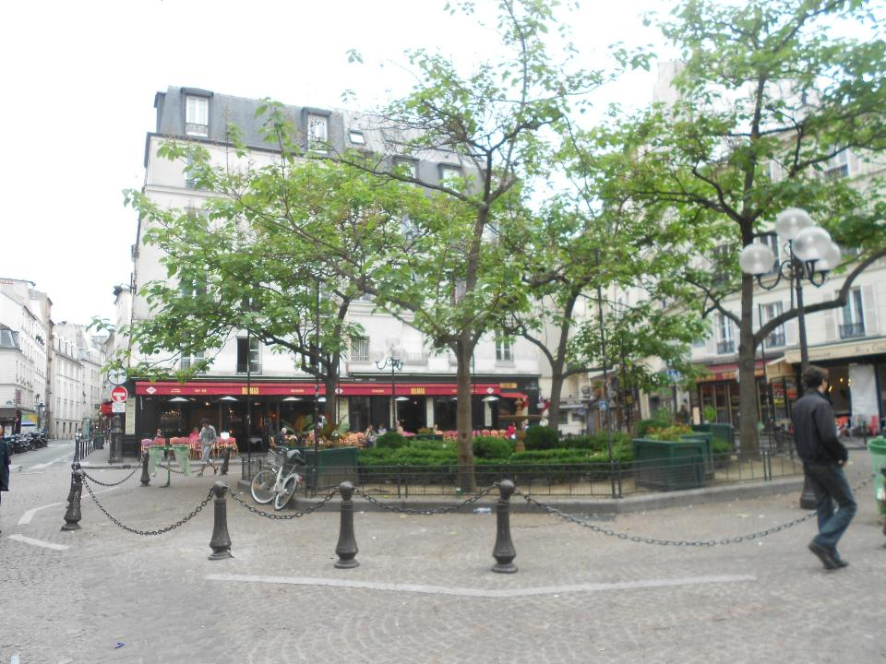
MOUFFETARD,
PARÍS

Slide 33
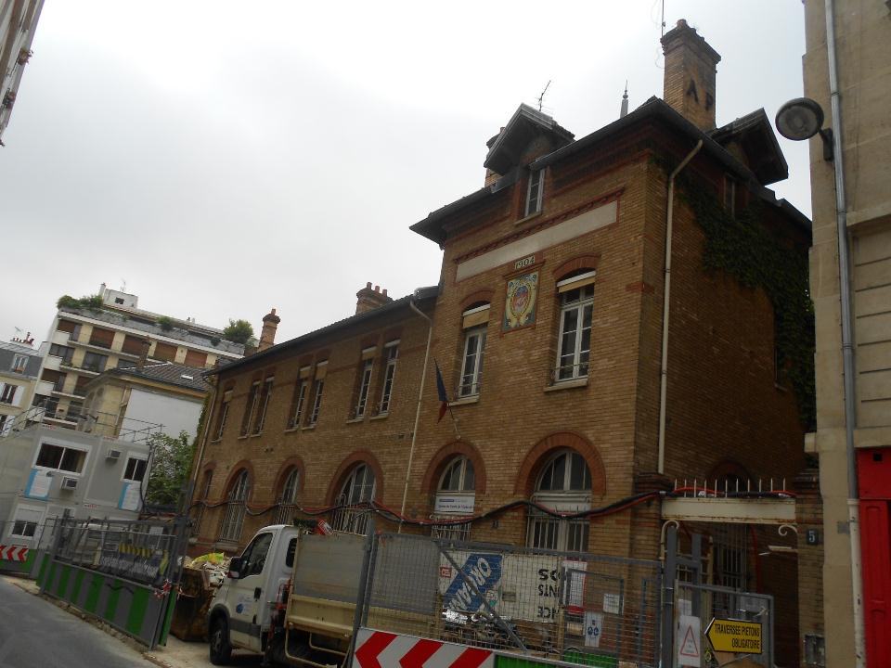
The place where Sister Rosalie cared for the poor

Slide 34
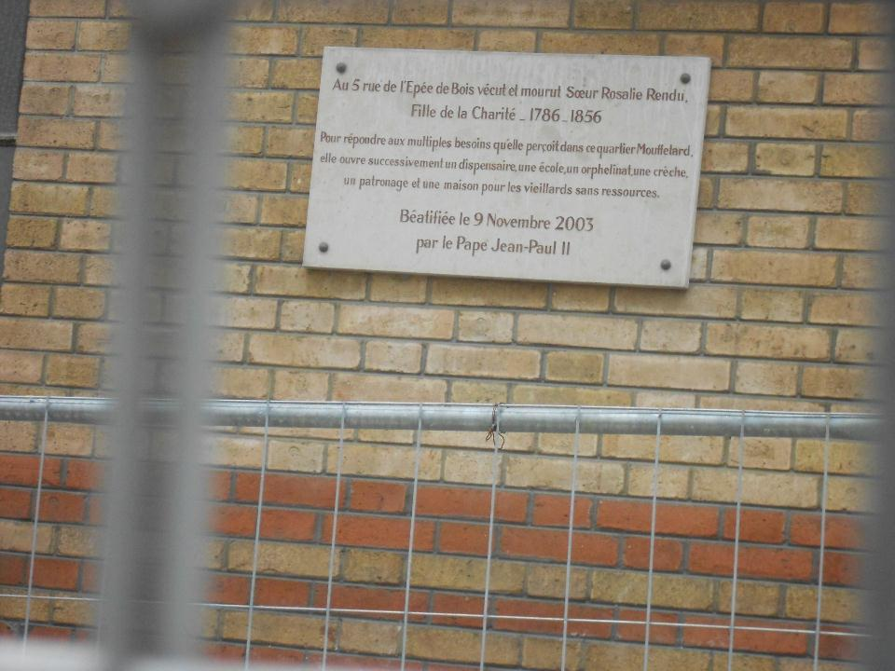
Commemorative plaque to the work of Sister Rosalie Rendu

Slide 35
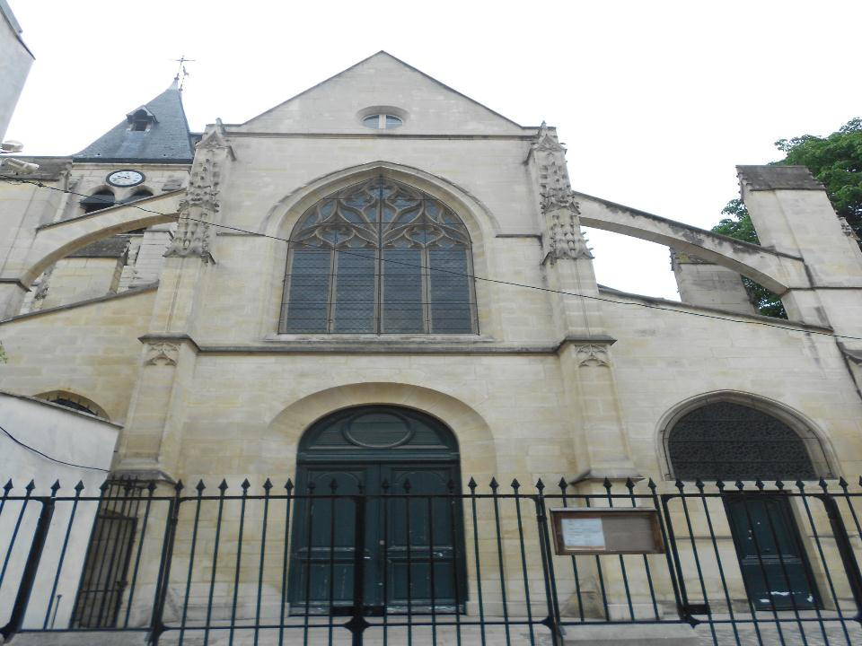
Church in the Mouffetard neighborhood

Slide 36
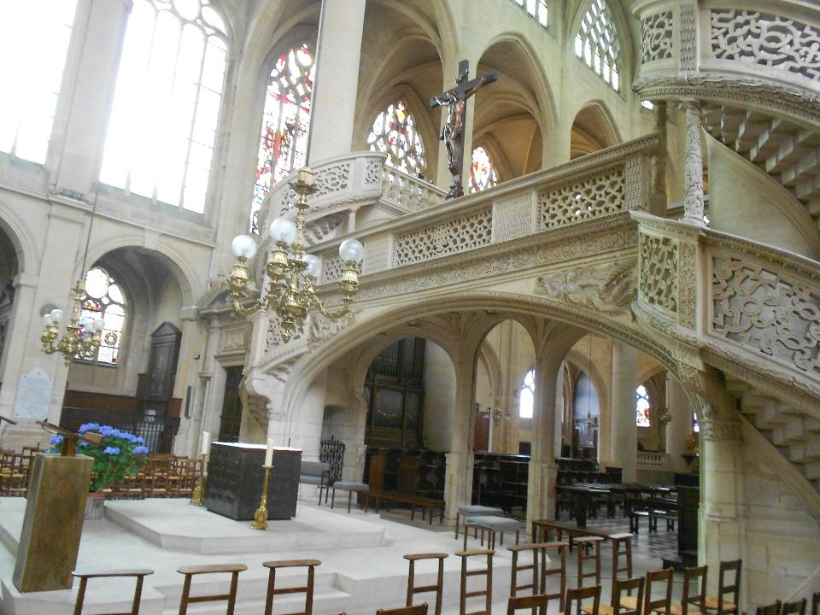
CHURCH OF SAINT ÉTIENNE DU MONT

Slide 37
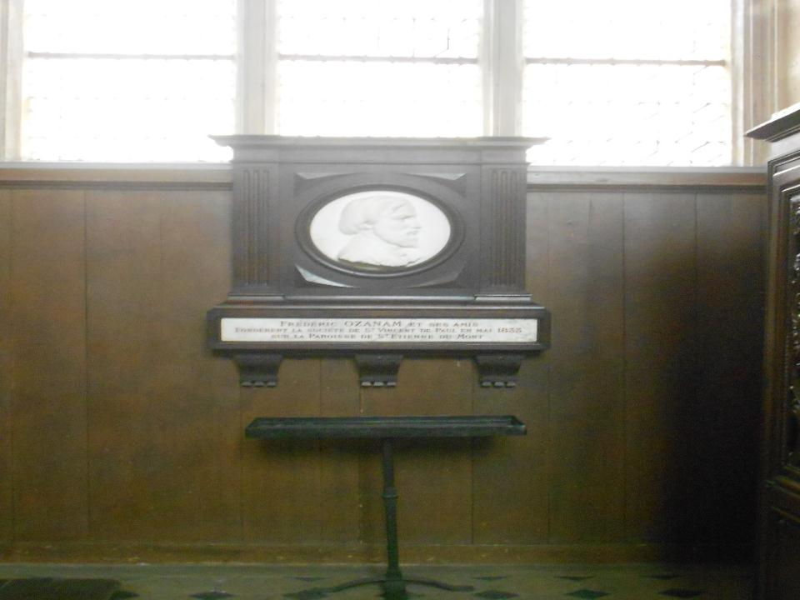
Remembrance of Frederic Ozanam in the Church of SAINT ÉTIENNE

Slide 38
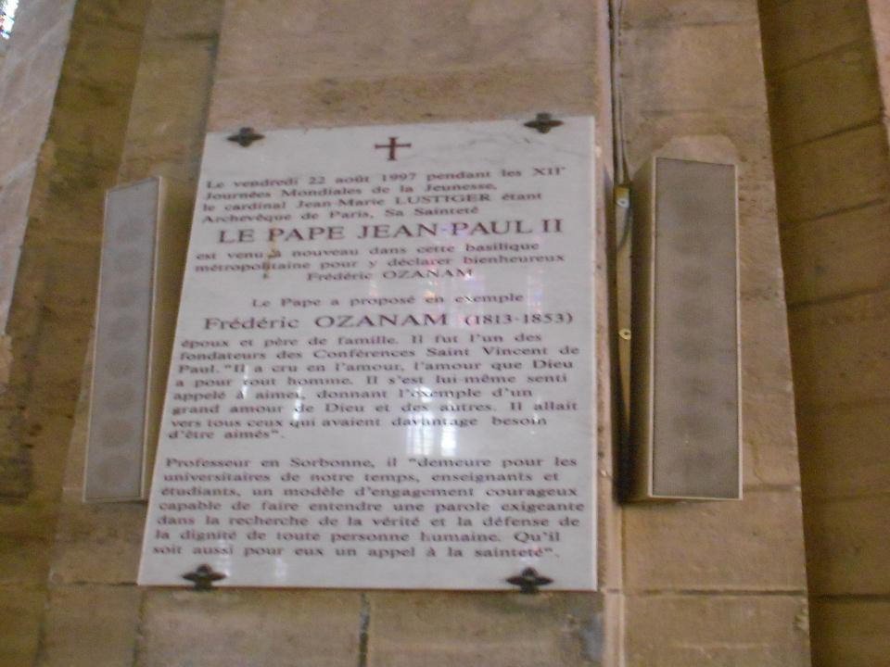
A Memorial Plaque of the beatification of Frederic Ozanam in the Cathedral of Notre Dame in Paris

