Slide 1
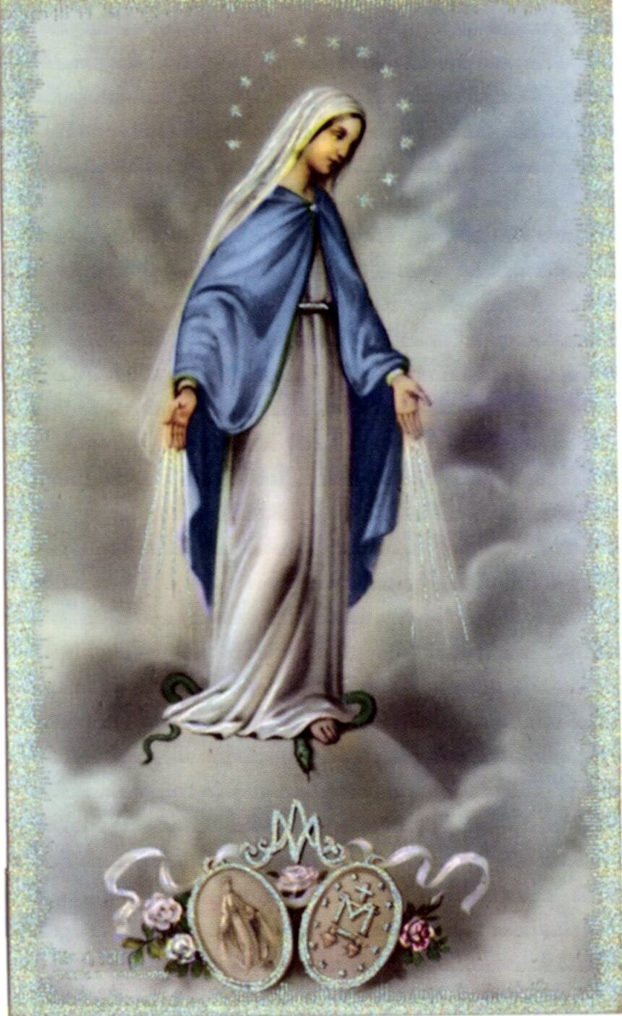
the first
miraculous medals
30 June, 1832

Slide 2
her message Not Heard
In 1830, after the apparitions of Mary to St. Catherine Labouré, she told only her community’s chaplain, Father Aladel, of her experience. To her dismay, he dismissed her account, telling her she must have been dreaming.

Slide 3
Catherine finishes Seminary; is sent on Mission
Some months after the apparitions, on January 30, 1831, Catherine finished her Seminary and received the habit of the Daughters of Charity. The next day, she set off for the Hospice of Enghien, which had been established by the Orléans family and was located at 12 rue de Picpus on the east side of Paris, in an impoverished neighborhood.

Slide 4
The Medal Must Be Struck
This was the beginning of Sister Catherine’s 46 years of service to the elderly and poor persons, quietly and in complete obscurity.
So, she set about her work; however, an interior voice kept insisting that the Medal must be struck.

Slide 5
A little Trivia
The site where St. Catherine Labouré worked for 46 years, until her death in 1876, is still active. In the 1970s, the buildings were demolished and replaced by the Catherine Labouré retirement residence, hosting a large community of Sisters.
Website

Slide 6
Finally Convinced
Catherine spoke about it again to her confessor, Father Aladel. At this point it had taken him nearly two years to be convinced. To his surprise he promptly received permission from the Archbishop to accede to Catherine’s request.

Slide 7
First 2000 Medals
In February 1832 a terrible cholera epidemic broke out in Paris and would cause more than 20,000 deaths.
The first 2000 medals were delivered on 30th June, 1832.

Slide 8
Miracles
The Daughters of Charity began to distribute the first 2000 medals produced at Father Aladel’s request. Cures accumulated, as did protection from the disease and conversions. It was overwhelming. The people of Paris began to call the medal “miraculous”.

Slide 9
By 1836…
By the year 1836 several million medals had been sold.

Slide 10
Sources:
mysticsofthechurch.com, chapellenotredamedelamedaillemiraculeuse.com

