Slide 1
Zafèn A Micro-finance Project in Haiti

Slide 2
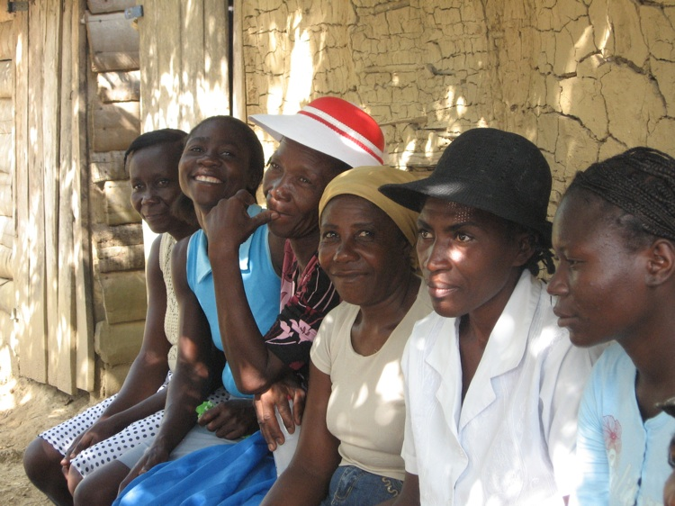
A Pilot Micro-Finance Project in Haiti

Slide 3
Why Haiti?
9.8 million people
Poorest country in the western hemisphere
7th poorest country in the world
54% of the people live on one dollar a day; 80% live on two dollars a day

Slide 4
Why Haiti?
47% of the population is illiterate
Unemployment is estimated at 60-70%
Life expectancy is 52 for men and 56 for women
In 1923, more than 60% of land was forested; in 2010, less than 2%

Slide 5
How can people get involved?
Make micro-loans or donations as individuals
Make micro-loans or donations as groups (the province, a house, a parish, a school, a class)
Give micro-credit as a gift (e.g., for a birthday or for graduation)
Offer a year-long scholarship, with food, for a primary school child
Help in re-forestation (plant a tree)

Slide 6
Website
WWW.ZAFEN.ORG

