Slide 2


Slide 3
SIMPLICITY
“Jesus, the Lord, expects us to have the simplicity of a dove.”
From Praying with Vincent de Paul
Thomas McKenna

Slide 4
SIMPLICITY
Do I always speak the truth?
Do I say things as they are or as I want them to be?
What causes me to conceal or hide something from another?

Slide 5
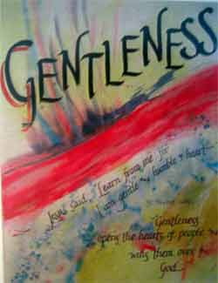

Slide 6
GENTLENESS
“There are no people more constant and
firm in doing good than those who are gentle and gracious.”
From Praying with Vincent de Paul
Thomas McKenna

Slide 7
GENTLENESS
Do you try to resolve conflicts with gentleness?
Do you know when to be gentle and when to be forceful?
Do you know how to temper your anger so to be gentle in a given situation?

Slide 8
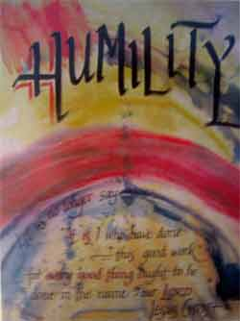

Slide 9
HUMILITY
“God pours out his inexhaustible gifts on the humble, those who recognize that all good done by them comes from God.”
(Documents, vol.11, pp. 56-67)

Slide 10
HUMILITY
Do I recognize the truth of who I am?
Do I protect myself by intimidating others?
Do I cause others to be on the defensive?
Do I treat people as well as I think I should?

Slide 11
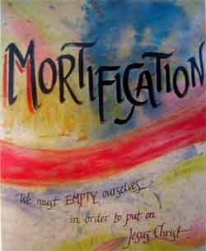

Slide 12
MORTIFICATION
“Service to God’s people demands a price. Christians must put aside their
own prejudices, comfortable circumstances, and favorite ideas in order to do
the will of God.”
From Praying with Vincent de Paul
Thomas McKenna

Slide 13
MORTIFICATION
How would you define mortification?
When was the last time you gave up something good to do a better thing?
How do you experience mortification in your daily life?

Slide 14
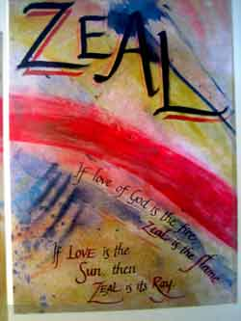

Slide 15
ZEAL
“Zeal is made up of a genuine desire to please God and to be useful to others: zeal for extending God’s kingdom, zeal for achieving others’ salvation.”
From Praying with Vincent de Paul
Thomas McKenna

Slide 16
ZEAL
How does your life reflect your passion and love for life in Christ?
“Zeal adjusts, finding new ways and developing professionally, especially through on-going formation.” (The Way of St. Vincent, Robert Maloney)
What have you done for your own on-going formation?

Slide 17
SIMPLICITY
Some signs of growth
Congruence between word and deed
Is transparent - especially in regard to motivation
Is honest (truthful)
Is single-hearted
Can reveal his inner self to others in an appropriate way
Has a clear self identity
Lives without the clutter of unnecessary concerns and things
Is authentic
Some signs for need growth
Incongruence between word and deed
Manipulates others
Has hidden agendas
Has a divided heart
Is preoccupied with frivolous concerns and things
Is perceived by others as a phony and a hypocrite
Is confused about his true purpose in life (confused self-identity)
Emmet Nolan, cm

Slide 18
HUMILITY
Some signs of growth
Recognizes God as the source of all life - especially his own
Depends on God and has confidence in God’s generosity and love
Loves self and others
Is profoundly grateful for his life
Appreciates even the small things in life
Enjoys life
Accepts gratefully all that is given
Does humble, hidden work for the community and the poor without calling attention to himself
Ability to admit mistakes and sinfulness
Offers and receives forgiveness graciously and generously
Ability to graciously accept correction from others especially the poor - who are his “Lords and Masters”
Ability to learn and be evangelized by others, especially the poor
Some signs for need growth
Depends on self
Self-identity is formed from his social status, interests and possessions
Expects privilege
Is ungrateful
Expects to be served
Ignores kind gestures from others
Is self-absorbed and narcissistic
Is seen by the poor as arrogant, aloof and demeaning
Is unwilling to do humble work
Expects to be praised for what he does
Does not admit mistakes
Does not offer forgiveness easily
Is a “know it all”
Is harmful to self and others
Emmet Nolan, cm

Slide 19
GENTLENESS
Some signs of growth
Appropriately expresses and controls anger
Is gentle and kind with others - even with those who are disagreeable
Is approachable and affable to others especially the most weak and vulnerable
Has good social skills - good manners
Is empathetic - can see and feel the world from the perspective of others, especially the poor
Avoids useless conflicts and arguments
Some signs for need growth
Does not express anger appropriately (e.g. sarcasm, gossip, hurtful words, bad moods, jokes with an edge, etc.)
Creates a tense and conflictive atmosphere
Argumentative
Often loses patience with others especially the poor
Has poor social skills - bad manners
Is avoided out of fear by others - especially the poor
Is disrespectful, rude and obnoxious
Emmet Nolan, cm

Slide 20
MORTIFICATION
Some signs of growth
Is self-disciplined
Is able to delay gratification
Willingly sacrifices personal convenience, comfort, goals, needs and security to enter into the world of the poor
Understands the central role of the cross in following Christ the Evangelizer of the poor
Is capable of fulfilling duties and obligations when they are not necessarily to his liking (without complaining)
Some signs for need growth
Is undisciplined in his appetites and desires
Does not fulfill his unpleasant but necessary obligations and duties
Complains often
Is unwilling to sacrifice personal convenience, comfort and security for the good of the mission
Puts personal well being before the needs of the community and the poor
Emmet Nolan, cm

Slide 21
ZEAL
Some signs of growth
Is enthusiastic and passionate about his life and work
Maintains a balanced but full schedule - works hard
Has pastoral initiative and creativity
Is hopeful and positive about the possibilities of the Kingdom of God
It is obvious to others that he loves what he is doing
Sees ongoing formation as a means of learning new and more effective ways of serving the poor
Some signs for need growth
Is apathetic and lazy
Has lost hope in the possibilities of Evangelization and the in-breaking of the Kingdom of God
Is “nesting” - does the minimum
Is pessimistic
Does not take creative initiative
Is bored with the mission
Emmet Nolan, cm

Slide 22
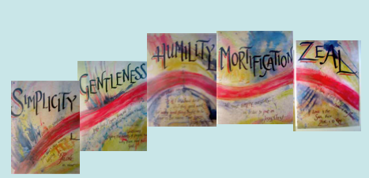
Artwork by Lynne Horoschak and Julie Ann Kring

