Slide 1
Leadership and Humility
The leader is called by God, and cannot be a good leader without God
To prepare a place for God in ourselves, we have to empty ourselves of ourselves
The way for doing the work of God is to remain close to Him in prayer
The real tool of the leader is the virtue of humility
Open to the promptings of the Son of God

Slide 2
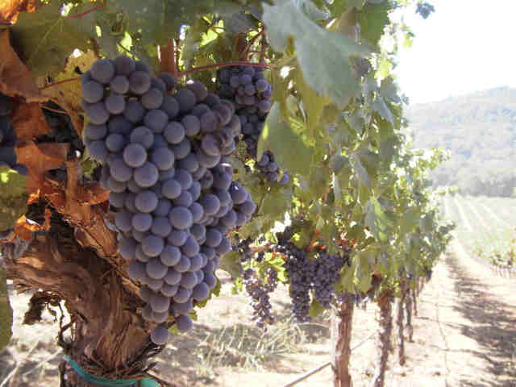
Called by God
God called you. You must have a great appreciation of what you are getting into
In opposition to the flood of vice and slackness

Slide 3
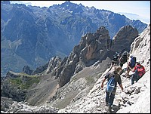
To guide others toward God

Slide 4
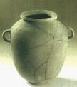

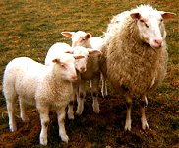
To prepare a place for God in ourselves, we have to empty ourselves of ourselves.
Empty yourself of yourself so that you can put on Jesus Christ.

Slide 5
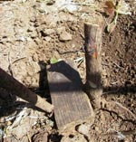
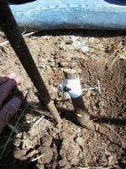
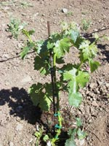
As a wild bush with a cultivated shoot grafted on to it, will produce the fruit of the graft…

Slide 6
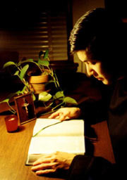
The way for doing the work of God is to remain close to Him in prayer
Important matters: close contact with the Lord in prayer
For learning what you have to teach
Sense of awe and experience of His love

Slide 7
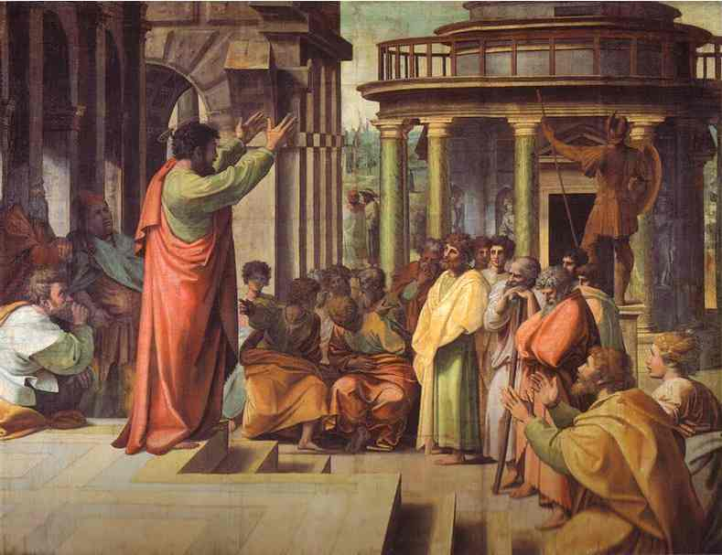
A man can go astray himself while guiding others toward salvation
Saul, after he had ascended the throne, lost God’s favor
St. Paul kept control of himself because he was afraid that, even though he had preached to others, he himself might rejected

Slide 8
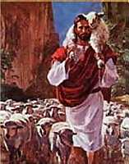
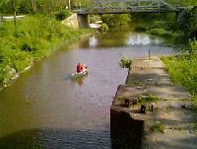
Stay close to our Lord
Be my shepherd
Do not let me miss the graces which you channel to others through me

Slide 10

Humility
Let us always keep an eye on what is human and imperfect, so that we can see plenty of reasons for being humble

Slide 11
Humility: don’t act as though you are superior
Jesus Christ told us that he came to be of service to others
Anyone who wants to be master should be everyone’s servant

Slide 12
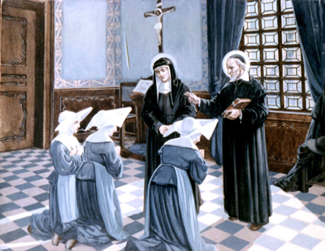
Humility: We should give God the credit for any good
Bear in mind that the leader is mainly responsible for all mistakes.
It is like the way the whole body is upset if a person has a bad headache.

Slide 13
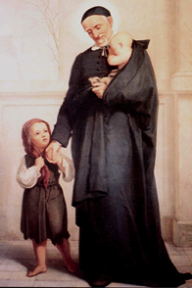
Humility also prevents complacency

Slide 14
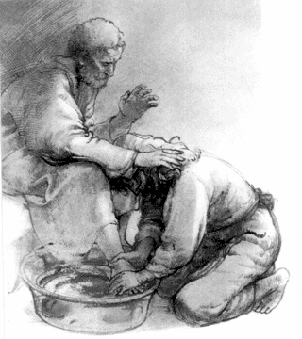
Humility: you will be able to speak with the humble mind of Jesus Christ
We recognize these comparisons: a field, a vine, a mustard seed

Slide 15
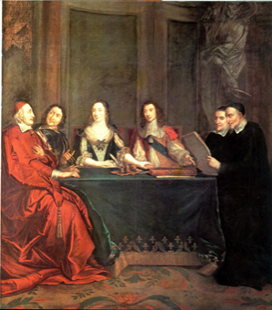
Open to the promptings of the Son of God
Is this in line with the teaching of Christ?
Lord, if you were in my place, how would you react to this situation?

Slide 16
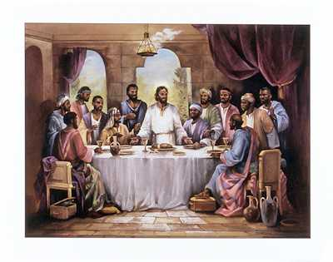
The leader must be a light for enlightening, and like salt

Slide 17
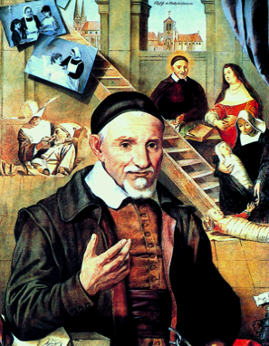
A leader has to deal with both spiritual and temporal affairs

Slide 18

We are not to be worried about tomorrow

Slide 19
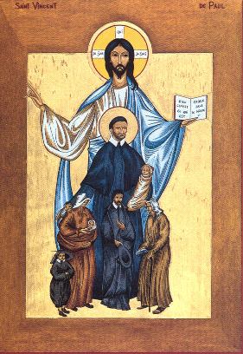
I ask our Lord to bless your ministry as a leader
Ask Him along with me to forgive all my faults

