Slide 1
Ten Principles to Facilitate Systemic Change

Slide 2
Vision
Have a holistic vision that addresses both individual and social needs, as well as spiritual and physical needs. Clearly articulate your hopes and dreams. Ask the question: “Where do we want to go?”
Have a holistic vision that addresses both individual and social needs, as well as spiritual and physical needs. Clearly articulate your hopes and dreams. Ask the question: “Where do we want to go?”
Have a holistic vision that addresses both individual and social needs, as well as spiritual and physical needs. Clearly articulate your hopes and dreams. Ask the question: “Where do we want to go?”
Where do we want to go?

Slide 3
Participation
Invite everyone to the table who has a stake in the outcome: administrators, staff, those living in poverty themselves.

Slide 4
Gather Data
Invite input from as many sources as possible to provide a clear picture of the situation.

Slide 5
Identify Root Causes
Look for the underlying factors which are causing the
problem(s).

Slide 6
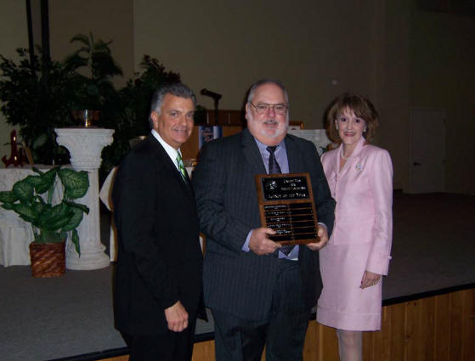
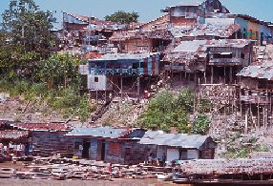
Network
Explore other agencies and/or persons who might have resources available; collaborate and engage in coalition building. Construct a shared vision with diverse stakeholders: poor communities, interested individuals, donors, churches, governments, NGOs, the private sector, and the media

Slide 7
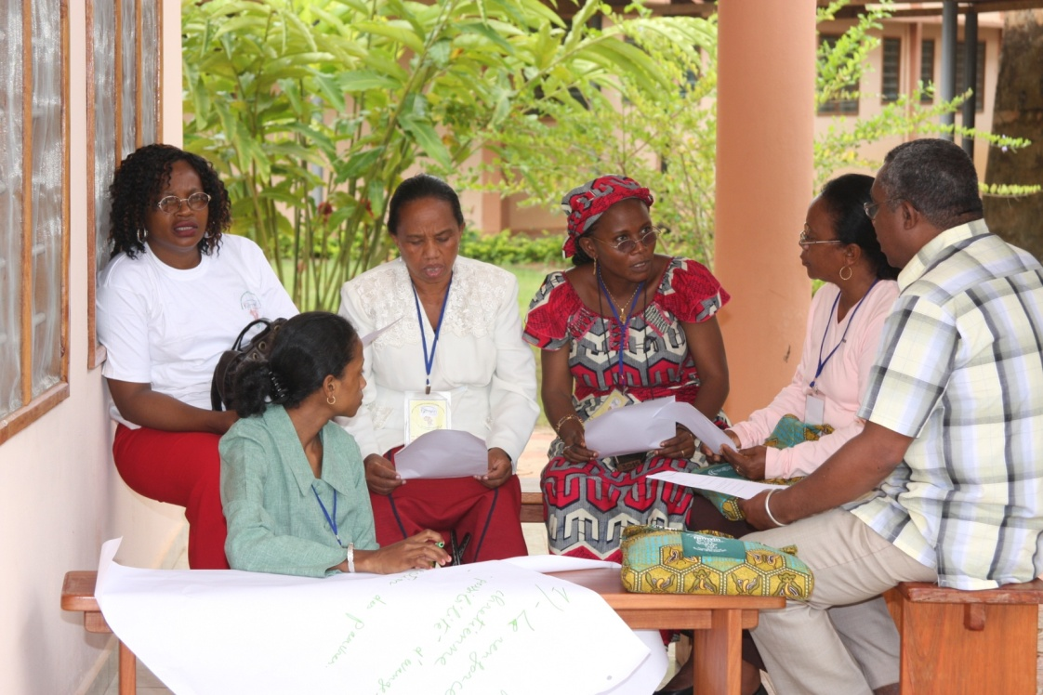
Capacity Building
Provide training and resources to all participants to enhance their ability to participate in their own development, both as individuals and as members of the organization.

Slide 8
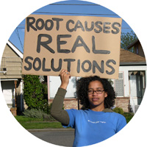
Design
Design a project or program which will meet the needs of your situation and help to eliminate the root causes of poverty.

Slide 9
Implement
Put your project or program into action involving all stakeholders.

Slide 10
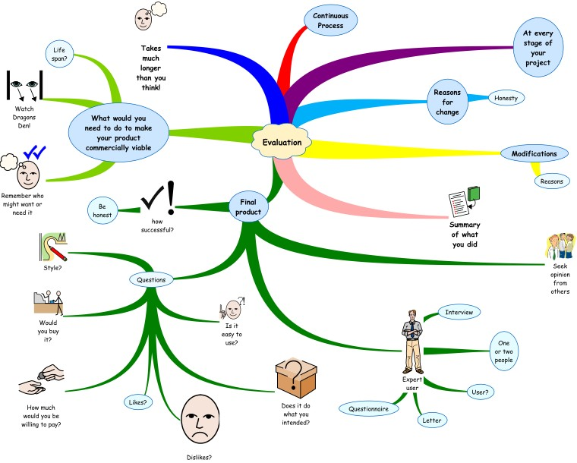
Evaluate
Create an evaluation process which engages all stakeholders; set up measurement criteria as an ongoing evaluation strategy.

Slide 11
Foster Transparency
Invite participation in all aspects of proposed projects.

