Slide 1
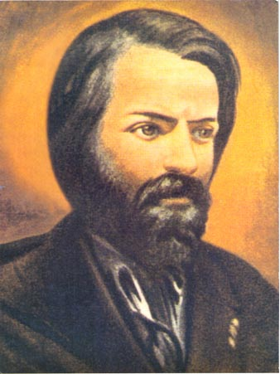
SPIRITUAL TESTAMENT

Slide 2
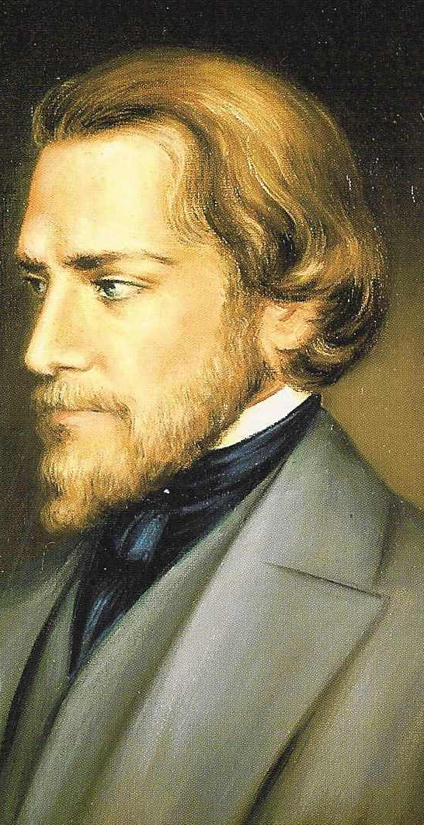
This day,
the 23rd of April, 1853,
on completing my 40th year,
in great physical sickness but sound in mind,
I express here in a few words my last wishes,
intending to set them forth more fully when I shall have more strength.

Slide 3
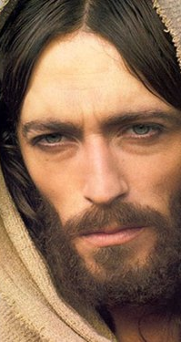
I commit my soul to Jesus Christ,
my Savior, frightened at my sins,
but trusting in His infinite mercy.

Slide 4
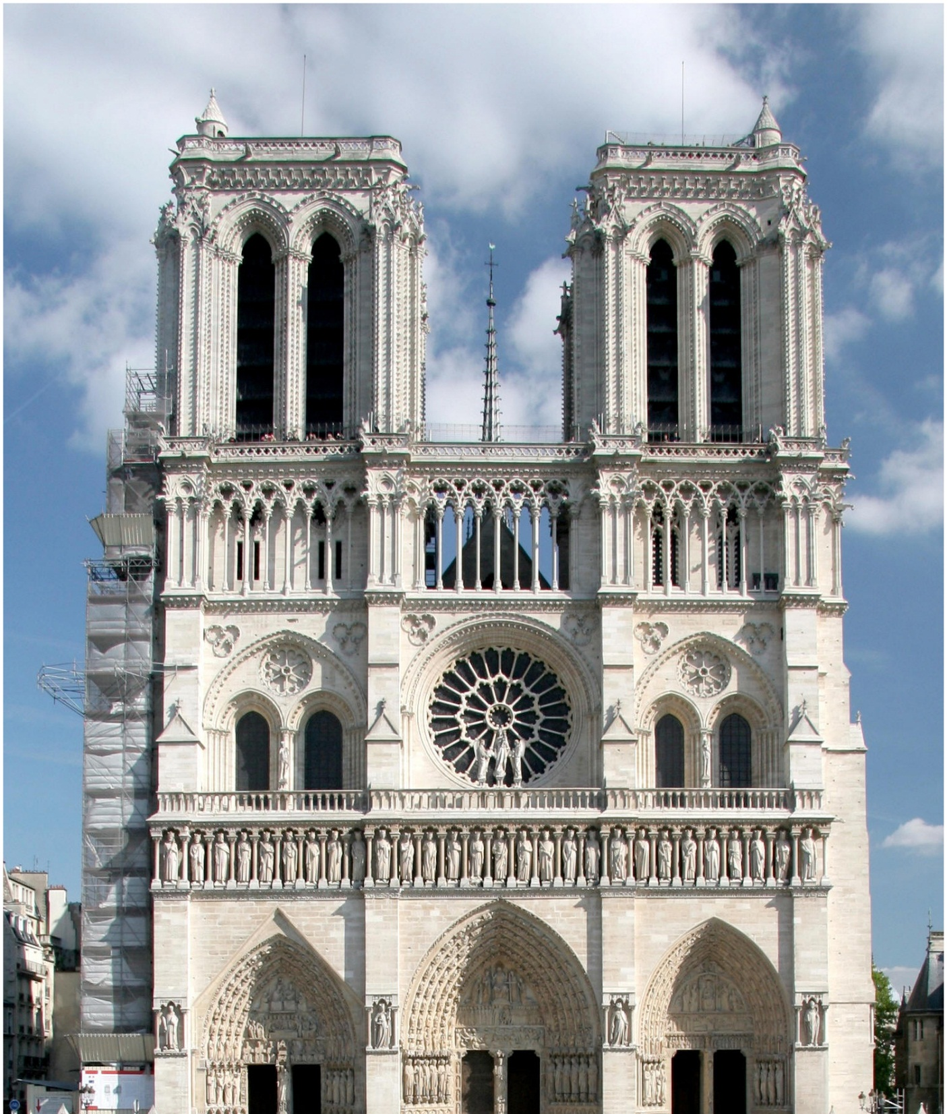
I die in the Holy, Catholic, Apostolic, and Roman Church. I have known the difficulties of belief of the present age, but my whole life has convinced me that there is neither rest for the mind nor peace for the heart save in the Church and in obedience to her authority. If I set any value on my research, it is that it gives me the right to entreat all whom I love, to remain faithful to the religion in which I found light and peace.

Slide 5
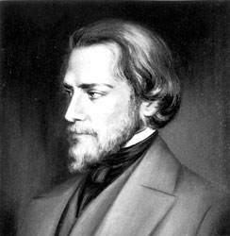
My supreme prayer for my family, my wife, my child, and grandchildren,
is that they will persevere in the Faith,
despite any humiliation, scandals or desertions which may come to their knowledge.

Slide 6
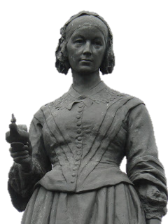
I bid farewell to my dear Amelie, who has been the joy and the charm of my life, and whose tender care has softened all my pain for more than a year. I thank her, I bless her, I await her in heaven. There, and only there, can I give her such love as she deserves.

Slide 7
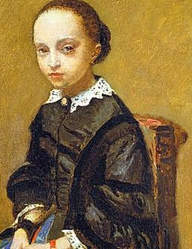
I give my daughter the blessing of the Patriarchs,
in the name of the Father and of the Son and of the Holy Spirit.
I am sad that I cannot labor longer at the wonderful task of her education, but I entrust this work to her good and beloved mother.

Slide 8
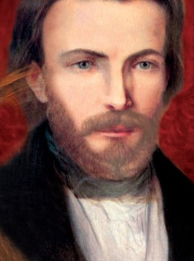
I give thanks for all those persons who in any way have served me and I ask forgiveness for my bad example and my impulsiveness.

Slide 9
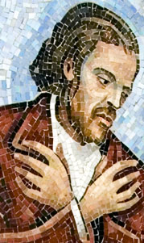
I ask you to pray for the members of the Saint Vincent de Paul Society in Lyon.

Slide 10
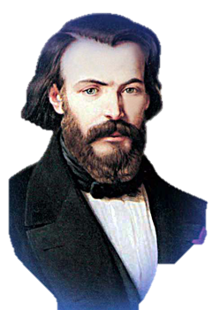
Do not allow yourselves to be stopped by those who will say to you, “He is in heaven.” Pray always for him who loves you dearly, for him who has greatly sinned. If I am assured of those prayers, I quit this earth with less fear.

Slide 11
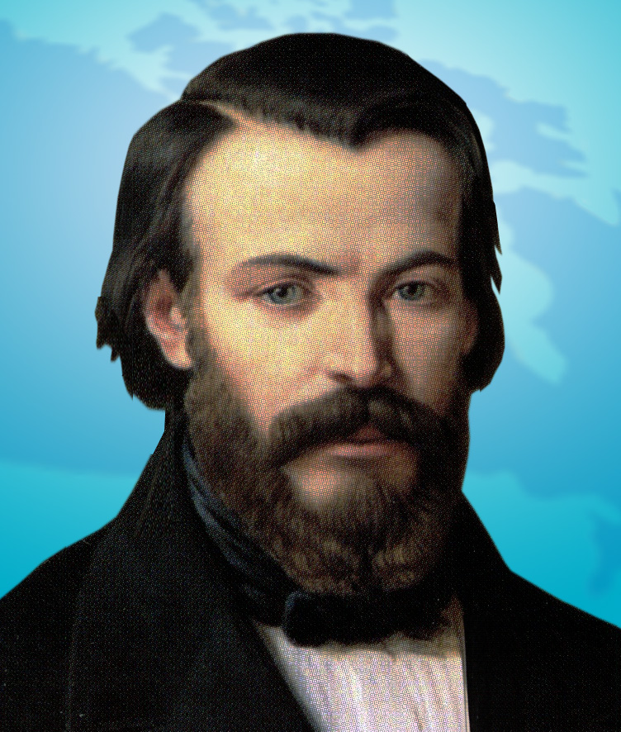
I hope firmly that we are not being separated and that I may remain with you until you come to me.
May the blessing of the Father and the Son and the Holy Spirit descend upon you. Amen.

Slide 12
