Slide 1
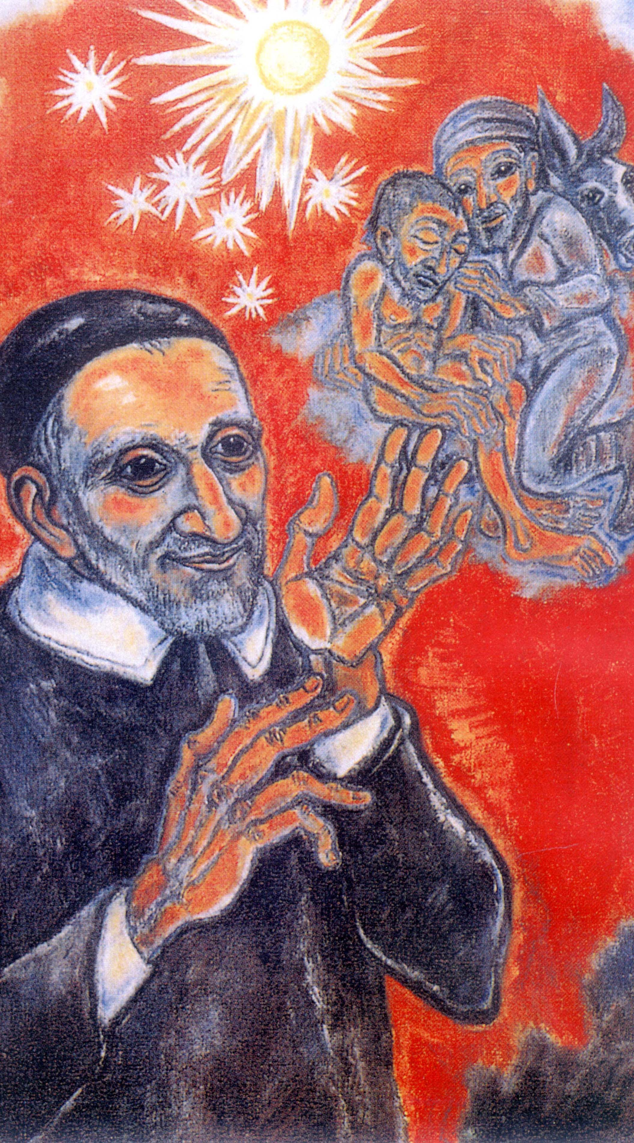
A Vincentian Reflection on Mercy and Justice Founder’s Week at St. John’s University
September 24, 2015

Slide 2
Let’s start with Webster’s Dictionary definitions of “mercy”:
Forbearance shown to an offender or to one under one's power;
lenient or compassionate treatment;
a blessing, an act of divine favor or compassion;
compassionate treatment of those in distress;
Which of these best describes how people today view mercy?

Slide 3
Mercy has deep biblical roots.
In the Old Testament, God enters into a covenant of mercy with Israel and renews it constantly. In Exodus, Moses encounters a God “who is gracious and merciful, slow to anger, and abounds in steadfast love and fidelity”. (Ex. 34:6).
In the New Testament, Jesus is “God’s mercy in person.”
By miracles, acts of healing, teachings, and release from sin and suffering, Jesus shows God’s unlimited compassion for Gentiles & Jews.
freebibleimages.org

Slide 4
New Testament Examples
Jesus shows us that mercy flows from the heart of God and is offered for the good of all.
Eating with tax collectors & sinners: “Jesus said, Go and learning the meaning of the words, ‘I desire mercy, not sacrifice.’ I did not come to call the righteous, but sinners.” (Matt: 9:13)
Multiplication of the loaves and fishes: “Jesus, seeing the crowds of people who followed him, realized that they were tired and exhausted, felt deep compassion for them.” (Matt. 9:36).
Healing of a demoniac : “Go home to your own people and tell them what the Lord in his great mercy has done for you.” (Mark.5:19)
freebibleimages.org

Slide 5
Now, let’s look at Webster’s Dictionary definitions of Justice.
The impartial adjustment of conflicting claims;
To assign merited rewards or punishments;
Determining rights by rules of law or equity;
being impartial or fair; conforming to a principle or ideal
Which of these best describes how people today view justice?

Slide 6
In a Christian context, Justice has a specific focus:
A moral virtue with a constant, firm will to give their due to God & neighbor;
Respect for the rights of all;
To establish harmony and equality in human relationships;
To promote the common good for all. (Catechism of RC Church-1807)

Slide 7
For a Christian, justice is relational:
Old Testament: “This is what the Lord God asks of you: act justly, love tenderly, and walk humbly with your God.” (Micah 6:8)
New Testament: “Seek first the Kingdom of God and his justice, and all will be given you. (Matt.6:33) “Blessed are those who hunger and thirst for justice.” (Matt 5:6)
In Catholic tradition, justice is not only a legal, juridical process, but a living law, based on love.

Slide 8
Vincent’s journey to mercy and justice
Vincent’s journey to mercy and justice began in pastoral ministry to God’s people in 4 places:
Clichy - parish work
Gannes - a memorable confession
Folleville – start of parish missions
Chatillon – a poor family that propelled him into organization

Slide 9
Vincent’s journey to mercy and justice
Vincent became a true “pastor of souls” converted to Christ, ready to serve his peoples’ needs
In these “far-off” places, Vincent learned to be pastor, confessor, and advocate for the poor
“The poor suffer more from a lack of organization than from a lack of charity.”

Slide 10
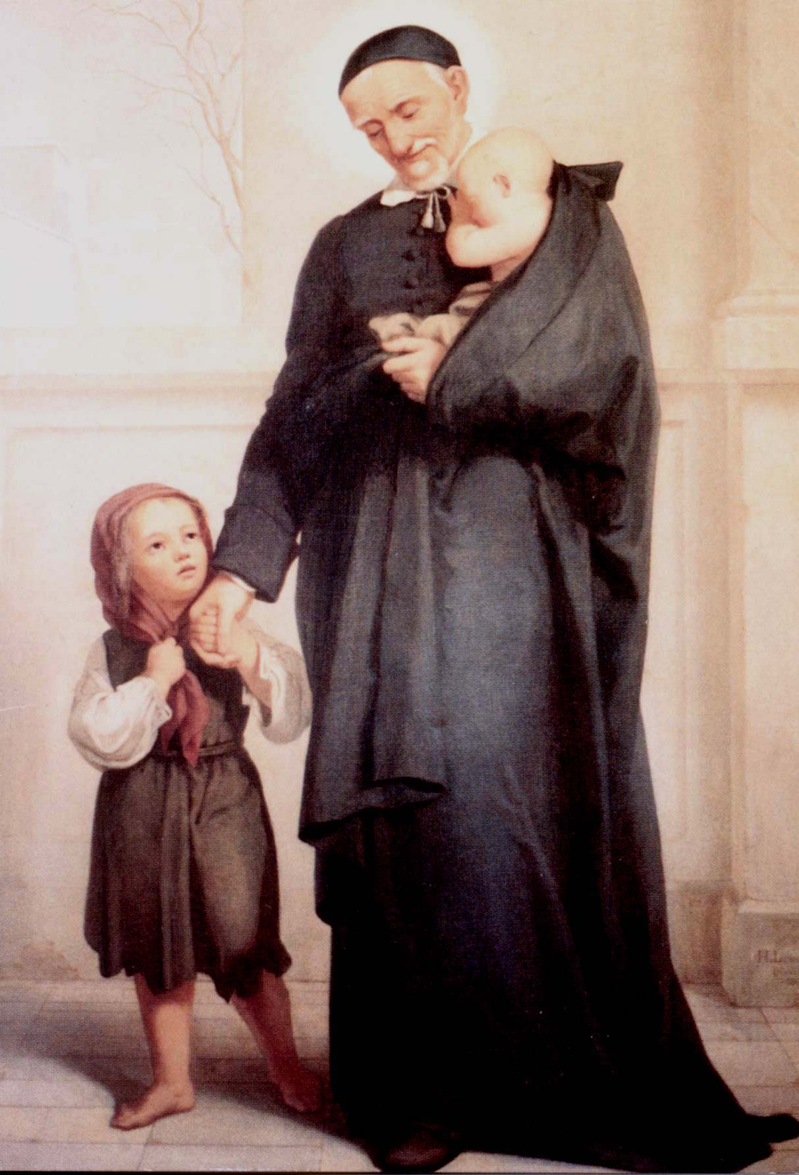
Vincent went through two critical, ‘life-changing’ moments:
Appointed chaplain of “galley slaves.” These were the lowest rung of prisoners, terrible treatment, with little hope of release. Vincent did not judge or shun them, but brought them pastoral care and better living conditions.
Abandoned children in Paris: Unwanted newborns of prostitutes, abused women often left them on Church steps. Called “children of sin”, but Vincent set up orphanages and created ‘drop-off points’ to preserve their lives. This was a hard sell, even for Vincent!

Slide 11
Vincent’s ideas on MERCY:
“It is a distinctive characteristic of God to be merciful. Let us ask God to fill us with His Spirit of mercy and compassion, so whoever sees us can say, ‘There is a person full of mercy!’” (CCD- Vol. 11, No. 308)
“God is well aware of our woes and limits. In his mercy, he supplies for our defects. Thus, act simply and do not become anxious. God’s goodness and mercy will provide whatever we need.” (CCD- Vol. 11, No. 129)

Slide 12
Vincent’s foray into JUSTICE:
French society tiered into privileged royalty with many ‘courtesans’ followed by a small group of professional and working class people. The majority were peasants (working poor), followed closely by the destitute poor, and refugees from numerous civil wars.

Slide 13
Vincent’s foray into JUSTICE:
Response to such a large, lower-tiered society: fatalism or apathy
Fatalism: ‘This is how it is meant to be by the design of God or the will of the King.”
Apathy: Nothing we can do to close the gap between classes of people

Slide 14
Vincent’s response:
Organize, motivate people to help the poor, and help them help themselves.
“No one is too rich to give, and no one is too poor to receive”
He founded two lay and two religious organizations: the Confraternities of Charity and Ladies of Charity, and the Congregation of the Mission and Daughters of Charity
Vincent tried to show France that poverty was a condition, not a crime. (Monsieur Vincent)

Slide 15
Vincent’s response:
The spiritual (pastoral) and temporal (physical) needs of the poor were equal in Vincent’s eyes
Core of Vincent’s thought is on justice based on Matthew 25:40, Parable of the Last Judgment: “Whatever you did for one of the least of mine, you did for me.”
Vincent constantly chose to ‘go against the grain’ providing for the basic needs of the poor, to fight for their basic rights, and to ‘humanize’ them.

Slide 16
Challenges
Sometimes, the challenges to Vincent’s ideals of justice and mercy came from within his groups:
Ladies of Charity- found regular service to the poor tiring, tried to send their servants instead.
Some early CM’s wanted only to focus on caring for ‘spiritual needs’ of the poor.

Slide 17
Vincent’s reply to these questions:
”Aren’t the poor the afflicted members of the Body of Christ? Aren’t they our brothers and sisters? And if priests abandon them, who will help them? If there are any among us who think they are in the CM to evangelize the poor, but not to alleviate their suffering, to take care of their spiritual needs but not their temporal needs, I say that we have to help and assist them in every way possible. To do this is to preach the Gospel by words and works; it is what Our Lord did and what we who represent him on earth should do.”
(CCD: Vol. 12-77-8)

Slide 18
So how can we “Look with love… move with mercy” as did St. Vincent?
Reflect on your experiences of God’s mercy in your own life… where did you find mercy, and how has it led you to better know the Lord?
How can you make your own life a better example of the justice and peace of God?

Slide 19
Want another tangible way to “look with love and move with mercy” like Jesus and Vincent did?
Follow Pope Francis on his trip to New York and Philly- not only where he goes, but what he says and how he says it… Read and reflect on his talks… And if you’re really ambitious,
Read his decree on the Year of Mercy: “Misericordiae Vultus” On Vatican web site www.vatican.va

Slide 20
Motto of Pope Francis: Miserando atque Eligendo
Quote is related to Jesus’ call of sinful St Matthew, means “Having mercy by choosing him”
That is ultimately our story. We are chosen by God’s mercy and it is meant to change our lives.

