Slide 1
blessed marguerite Rutan, D.C.
Snapshot of
Martyr of the French Revolution

Slide 2
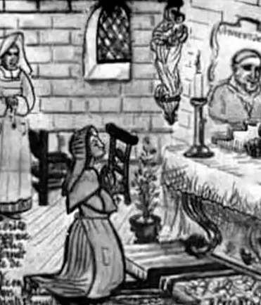
Marguerite Rutan was born in Metz in 1736. There, at the age of 20, she began her postulancy in a hospital as a Daughter of Charity. A year later, on her birthday, she entered the Seminary in Paris and just five months later she was sent to serve in a hospital in Pau.

Slide 3
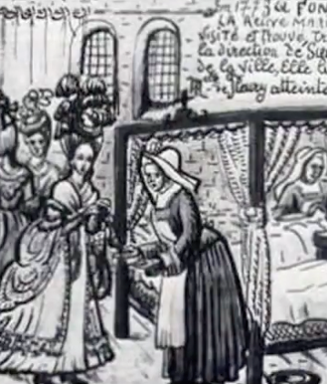
She had the happiness of seeing her two sisters enter the Company shortly after her and the sadness of seeing both of them die at a young age. From Pau she moved to several other hospitals, finally arriving in Dax, where she became Sister Servant in 1779.

Slide 4
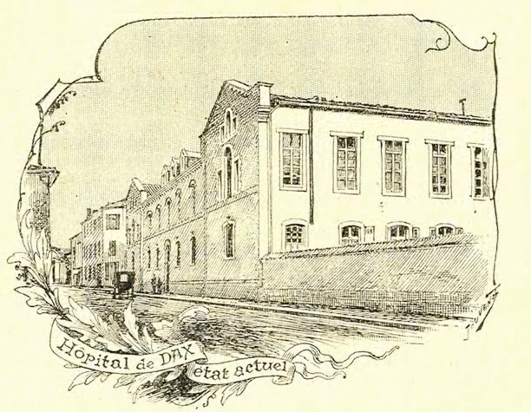
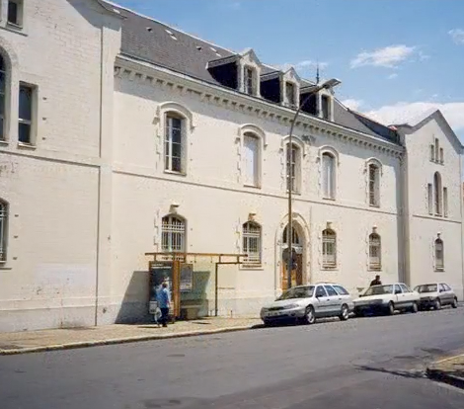
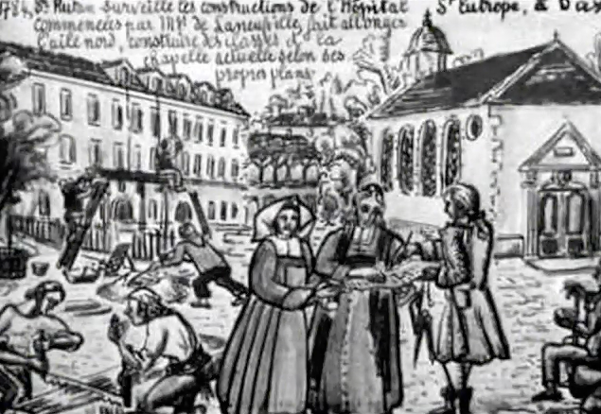
Dax Hospital, as it looks today

Slide 5
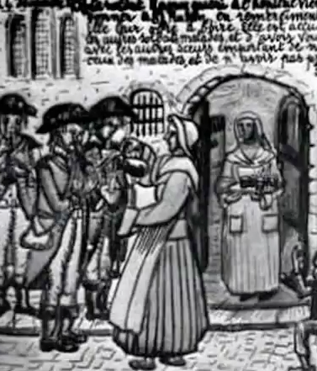
Ten years later, with the outbreak of the Revolution, life became increasingly difficult for the sisters. Resources for the running of the hospital were scarce. The government provided fewer and fewer funds. After October 3, 1793, all sisters employed in running hospitals and schools had to choose between taking the oath or leaving the institutions where they served. Sr. Marguerite and her companions refused the oath.

Slide 6
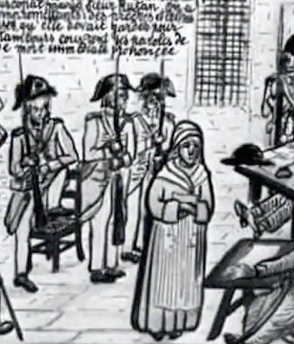
From then on they were constantly under surveillance, but their services in the hospital were so needed that they were allowed to continue. Finally, however, Sr. Marguerite was arrested on December 24, 1793, on charges of “corrupting and slowing down the revolutionary and republican spirit of the military who went into that hospital.”

Slide 7
What had happened in fact was that a group of soldiers, to express gratitude for the care given in the hospital, returned to play some songs for the sisters. Sr. Marguerite stopped to listen to them, gave them some refreshments and also some money. That was her crime. She was taken to the prison at the Carmelites’.

Slide 8
At the beginning of March 1794, a guillotine was constructed in the Place Poyanne in Dax.
Simultaneously, most prisoners were transferred to Pau, making the journey on foot, but Sr. Rutan was left in the Carmelite prison, a sign that her fate had already been decided.

Slide 9
After a brief trial, her name was placed upon the list of those to be guillotined. An extraordinary commission arrived in Dax to review the cases of those facing capital punishment. On April 9, after a brief hearing in which the same charges were repeated, Marguerite was condemned to death. The sentence was to be carried out immediately.

Slide 10
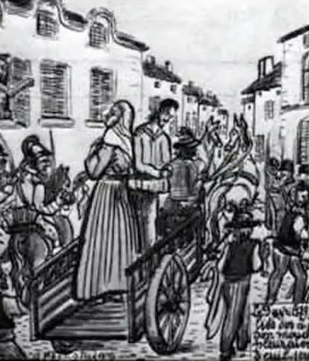
She and the Curé de Gaube, also condemned, were tied back to back, placed on a cart, and, surrounded by soldiers, rushed to the execution place to the sound of tambourines.

Slide 11
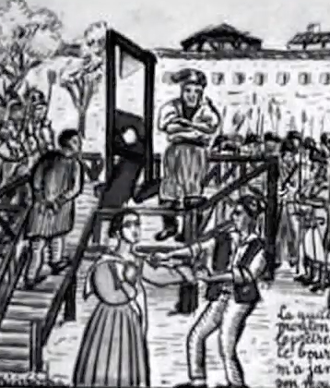
Having first witnessed the death of the Curé, she asked the executioner not to touch her as she herself removed the shawl from around her shoulders. She then placed her head on the guillotine and was executed.

Slide 12
What I find most remarkable in reading the accounts of Marguerite’s death was her dignity. She seems to have been undaunted, treating others gently, speaking her mind clearly and unflinchingly right to the end.

Slide 13
Source:
Maloney, Robert P., C.M. (2004)
Five Snapshots of Lesser-Known Vincentian “Saints”,
Vincentiana: Vol. 48: No. 1, Article 10.
Available at: http://via.library.depaul.edu/vincentiana/vol48/iss1/10
Drawings by B. Pécastaing

