Slide 1
sisters of charity of leavenworth:
mission in montana
Group photograph of Sisters of Charity of Leavenworth, circa 1930. Photo: Sisters of Charity of Leavenworth Archives

Slide 2
pioneers
The Sisters of Charity of Leavenworth, Kansas, came to Montana in 1869 to pioneer health, education, and social services in many Montana communities.
The Sisters journeyed in many different directions to serve. They were teachers and nurses. They established orphanages, schools and hospitals. They went to mining towns, big cities and small communities.
Mother Xavier Ross, circa 1868
Sisters of Charity of Leavenworth Archives

Slide 3
pioneering services
Parochial institutions in nineteenth- and early-twentieth-century Montana, which were almost exclusively under the supervision of women, were the forerunners of modern social services. Catholic nuns, Methodist deaconesses, and nondenominational Christian women offered comfort, sanctuary, and stability to the lost, the desperate, and the destitute. Their contributions were far-reaching and some of their pioneering services evolved and remain viable today.
Sisters of Charity of Leavenworth assist Doctors with
a surgery at St. Joseph’s Hospital in Lewistown. 1909.

Slide 4
schools and orphanages
Sisters of Charity of Leavenworth came to Helena in 1869 at the invitation of Jesuit priests who saw a dire need for feminine influence in the rough-and-tumble gold camp. The sisters’ mission was threefold—to teach youth, care for orphans, and minister to the sick—and it fit in with the real needs of the frontier community. St. Vincent’s Academy, the first boarding school for non-Indian girls, opened in 1870 and educated girls until 1935.
For a brief history of the area which became known as the state of Montana, click here

Slide 5
care for mentally ill
The sisters also cared for the indigent mentally ill until the founding of Warm Springs in 1877. There was no other place for these people, and their care was a dangerous undertaking. On one occasion, a violent patient escaped his restraints and overpowered a hired man and a priest. Sister Patricia calmly threw a mattress over the patient so that others could rush in and restrain him.
Sisters of Charity of Leavenworth Archives

Slide 6
child care
In addition, the Sisters of Charity founded St. Joseph’s Home, the territory’s first orphanage. In 1881, the Sullivan brothers of Butte (ages three, five, and six) were the first of hundreds of needy children to enter their care. After their mother died, their miner father could not care for them, so the sisters took the boys in and nurtured them. In time, Stephen and Ambrose would enter the priesthood and John would become a doctor.

Slide 7
other charitable institutions
Other Catholic and Christian groups began to arrive. In 1889 Sisters of the House of the Good Shepherd opened a sanctuary and school for “fallen women and wayward girls.” In 1896, the Women’s Christian Temperance Union were among the founders of the Florence Crittenton Home, which complemented the work of Good Shepherd. The Children’s Home Society, also founded in Helena in 1896, was a Protestant nondenominational alternative to the Catholic St. Joseph’s Home.
House of the Good Shepherd

Slide 8
Photo courtesy Western Heritage Center, Billings
Billings was the final Montana frontier of the Sisters of Charity of Leavenworth. In 1896, Father Clarence Van Clarenbeck and Billings mayor Dr. Henry Chapple traveled to Leavenworth to make an appeal to the Mother House. The need for a hospital in the bustling railroad town of 3,000 would soon be critical. Mother Mary Peter Dwyer assigned two Sisters from St. John’s Hospital in Helena to assess Billings’ needs. Dr. Chapple, who was not Catholic, had lamented a chronic shortage of nurses throughout his career. He challenged the Sisters and they accepted, caring for patients first in makeshift quarters above Chapple’s drug store. The first patients were admitted to St. Vincent’s Hospital in 1898. In 1916, infantile paralysis afflicted at least 125 children in Billings. When Mother Irene McGrath, Superior of St. Vincent’s, established a children’s ward for these young patients, the overcrowding this caused underscored the need for a new building.
When the new 200-bed hospital opened in 1923, Mother Irene opened a school for children whose deformities had heretofore prevented their education. It was the first school of its kind in the West. These efforts laid the groundwork for Billings’ modern medical and social services. The Sisters of Charity of Leavenworth Health Care remains today St. Vincent’s parent system.

Slide 9
lifesaving work
Networking among the women of these early institutions, established before child welfare systems and other social services were in place, speaks to the heart of those who strove to do the best they could for those under their care.
The early matrons and mother superiors of these homes, whether Protestant or Catholic, often did lifesaving work.
Sisters of Charity of Leavenworth Archives

Slide 10
education
Parochial education also evolved under the auspices of women in Montana, and it was often intertwined with social services. Various orders of Catholic sisters opened schools in many Montana communities, including Helena, Missoula, Great Falls, and Billings. By 1908, Catholic schools were serving 5,536 of the 61,928 children enrolled in Montana schools, not including reservations.

Slide 11
late 20th century to today
Child welfare services and the foster care system eventually replaced the early children’s homes. Most Catholic institutions closed in the 1960s and 1970s.
Some of the Protestant institutions, such as the one pictured here, continue to serve needy Montanans.

Slide 12
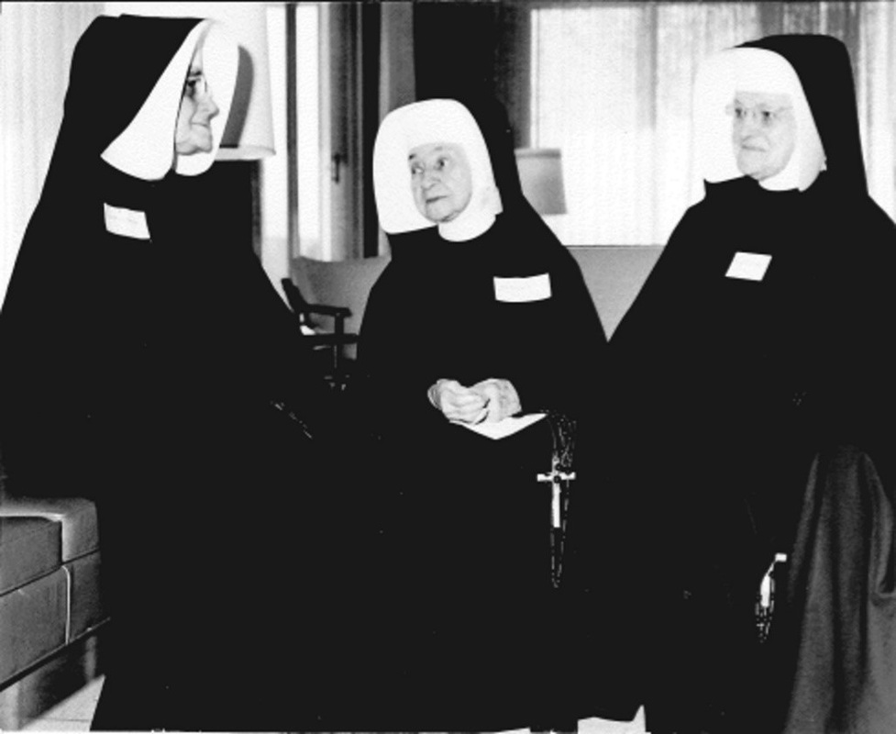
legacy
The institutions that took root in Montana speak to the caring groups and individuals who left important sustainable legacies. Their contributions have been monumental and their influence far-reaching.

Slide 13
Sources:
“Women’s History Matters” blog
http://montanawomenshistory.org/early-social-service-was-womens-work/
Sisters on a Mission (SCL Archives)
http://sistersofcharityofleavenworth.weebly.com
“Montana Moments” blog
http://ellenbaumler.blogspot.com/2013/03/st-vincents-in-billings.html
Sisters of Charity of Leavenworth website
http://www.scls.org/Who-we-are/Our-History.aspx

