Slide 1
The counter-cultural,
action-proven spirituality
of the Society of St. Vincent de Paul
Based on the Vincentian Heritage Journal Article:
“Frédéric Ozanam's Tactical Wisdom For Today's Consumer Society”
by Thomas McKenna, C.M.

Slide 2
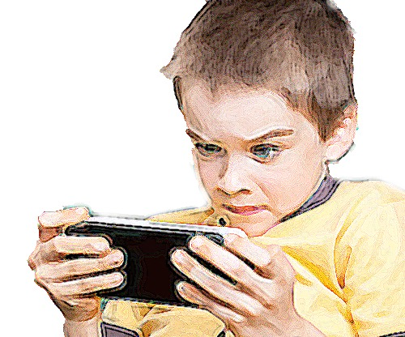
The mentality that drains the deeper meanings from a person's world-view, or
... 5 Things Important to This Generation
(anyone who interacts with children or young people will be familiar with these)

Slide 3
#1: Appearance
What is important:
whatever strikes my senses first
what catches my attention and breaks through the clutter
the allure of its packaging
image, not substance
What happens:
My interest shifts from whether there is truth in an object, to whether it is interesting.
I grow more tolerant of artificiality and insincerity.
I am conditioned to tell myself that this is simply the way of the world.

Slide 4
#2: Ability to Entertain
What is important:
how intensely something stirs up my sensibilities and engages my emotions
how vivid and kinetic something is
whether this product gives me an intense feeling, whether good or bad
the "rush factor"
What happens:
I become conditioned to take in everything, including evil, as entertainment.
I am not motivated to take effective action against moral evil. I only respond superficially.

Slide 5
#3: The Thirst for Novelty
What is important:
the next product in line that will satisfy me — or at least come closer to doing so
also called "the cult of the next new thing"
What happens:
When I tire of the present activity, I move onto the next new thing.
I am chronically disappointed.
I can't handle long-term commitment or persevere in the pursuit of a goal.

Slide 6
#4: Customization
What is important:
The ability to tailor things to my personality, to my unique style
carving out a distinctive social identity
making a statement about my signature style
a climate that showcases individualism
What happens:
I am not satisfied with things anybody else can own.
I am too cool or different to cooperate with others in a group endeavor.
I tend to dabble rather than have long-haul commitments

Slide 7
#5: Abstraction
What is important:
Interchangeable world-views, smoothed down, mix and match as I please
Ideas that do not ask much from me
Collages of ideas that are attractive because they fit my image or my mapped-out plan in life
What happens:
I pull particular realities, especially religious traditions, away from their fuller context for use in my own setting
I am unwilling to inconvenience myself to respond to moral challenges

Slide 8
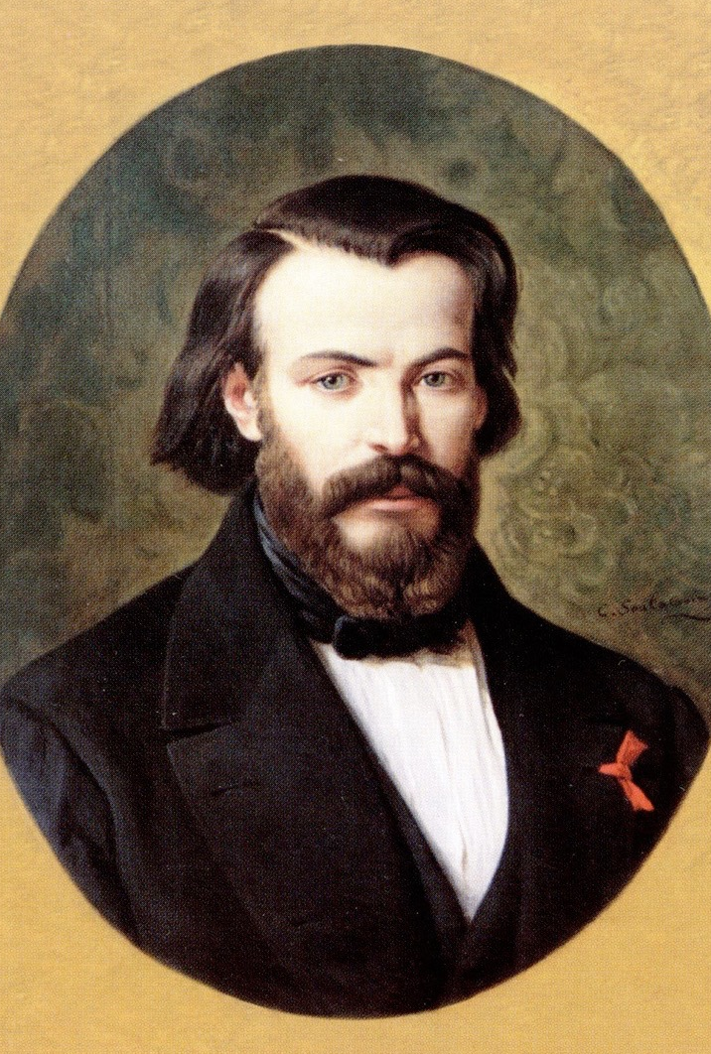
Frederic Ozanam’s
5 Solutions
or,
the counter-cultural, action-proven spirituality
of the Society of Saint Vincent de Paul
or, How To Resist the Shallow "Commodity Culture"

Slide 9
#1: Concretize the Abstraction
How:
The Home Visit
(Frederic's insistence on regular face-to-face contact with the people he would serve)
What happens:
Interacting with people on a regular basis in their home setting does not allow for much disconnected theorizing about how to help them.
I cannot bend or romanticize the conditions of their world.
I feel the obligation to do something about it.

Slide 10
#2: Ground yourself in tradition
How:
Theological Reflection (another of Frederic's practices, both at Conference meetings and outside of them)
Tie your charitable work to the Gospel and the beliefs of the Christian tradition
Enhancing the faith by word and deed
What happens:
I begin to forge links between the religious riches of the Christian inheritance and life's experience, particularly service experience.
This helps steer the charitable work I do and also gives it additional staying power.

Slide 11
#3: Work together, not alone
How:
Communal Efforts
Frederic always sought out compatriots to stand with him in the face of the cultural winds that were blowing in his day. Again and again, he thanked God for the building-up each member gave to the others.
What happens:
I begin to value the quality and depth of relationships within my Conference
I discover the influence that older members can have on the younger
I begin to build lively contacts between Conferences
I experience the joy of working closely together

Slide 12
#4: Marry practice and theory
How:
Do something! and learn
Frederic knew that real-life practice feeds back into theoretical claims. The evolution of his academic ideas about charity and Church-State collaboration happened in large part because of his experience of serving the poor of Paris.
What happens:
I, and the Society as a whole, are called to consider again the blessings that come from intertwining intelligent theory and on-the-ground operation.

Slide 13
#5: Resist the notion that everything can
be marketed, bought, and sold
How:
Encounter God in the poor
Frederic esteemed tradition and regarded it as a living and encompassing thing, not at his disposal as some commodity. He regarded the poor as priceless and would not reduce them to categories, statistics, or noble-feeling causes.
What happens:
I look at tradition as a table from which to nourish my mind and heart
In the footsteps of Ozanam, Rosalie Rendu, St. Vincent de Paul, and Jesus Himself, I have regular interaction with poor persons

Slide 14
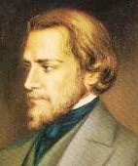
Frederic Ozanam had a reverential spirit. He knew that God is not some commodity, some appealing product we can take, leave, or suit to our tastes, but rather the encircling and all-pervading source of life!

Slide 15
