Slide 1
Real, Simple:
St. Vincent de Paul
practicing simplicity (honesty)

Slide 2
We are bombarded by images.
We are attracted; they have sizzle, they are sexy.
Do they deliver on what they promise?
Are they true?

Slide 3
So many false images have taught us to mistrust.
There is a disconnect between appearance and substance.

Slide 4
Are celebrities real?
Is this only a face?
Does this face have depth to it?
There is a disconnect between image and reality.

Slide 5
We’ve become skeptical.
We don’t trust the link between symbol and symbolized.
Are you really as you present yourself?

Slide 6
St. Vincent de Paul was real.
He speaks to our skepticism about truth in packaging.

Slide 7
St. Vincent presents a world of honesty and simplicity.
Our world says: it doesn’t matter whether words have backing, statements have depth, gestures have follow-through.

Slide 8
St. Vincent was very “present to” people.
People disagreed with him, people opposed his ideas,
but there is no record of anyone
who did not consider him genuine.

Slide 9
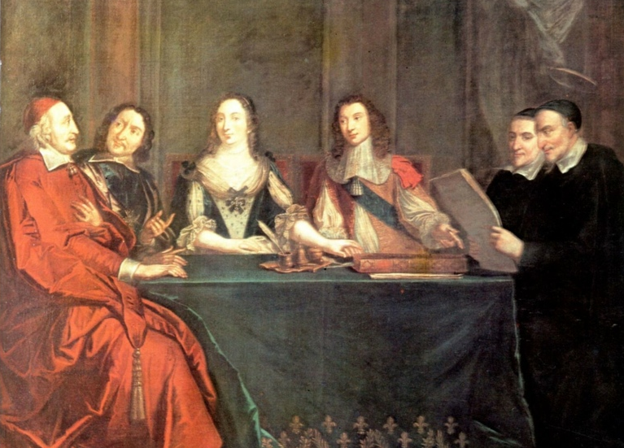
St. Vincent moved in an intrigue-filled world: the French Royal court. There was drama and controversy.
Yet people on all sides trusted him. He also had nationwide credibility among the regular people, the poor people in the cities and in the country.
He was believable to both the rich and the poor.

Slide 10
In many letters and conferences, St. Vincent said that being genuine was his most important personal value, and that in fact he spent his whole life making sure he stayed genuine.
His word for this was: Simplicity

Slide 11
What would St. Vincent say
to his followers today?
Tell the truth
Keep it real
Be consistent in your words, your appearance, and your substance

Slide 12
No hidden agendas
Don’t be two-faced
Don’t try to be clever
Tell it like it is
Make simplicity your gospel

Slide 13
Why was simplicity so valuable to St. Vincent?
First, because God Himself is this way.
Second, it is impossible to be effective as an apostle without it. Why?

Slide 14
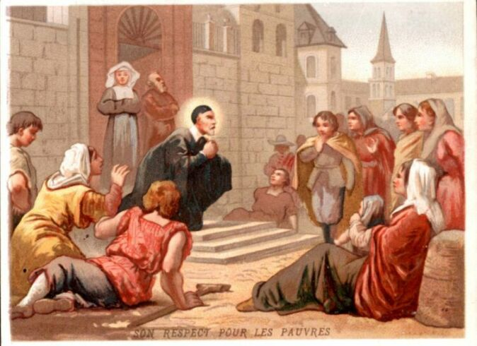
Because if people see that your words do not match
what is really inside you, they will not hear your preaching nor will they accept your ministries.

Slide 15
Think about this: it’s pretty hard to fool a poor person. They’ve seen it all, and they can see through a clever talker. You can’t doubletalk them for long.

Slide 16
St. Vincent knew this. To bring the Good News to these individuals (Vincent’s life mission), his language had to come from his heart. And our service has to come from respect for others, not from some masked self-interest.

Slide 17
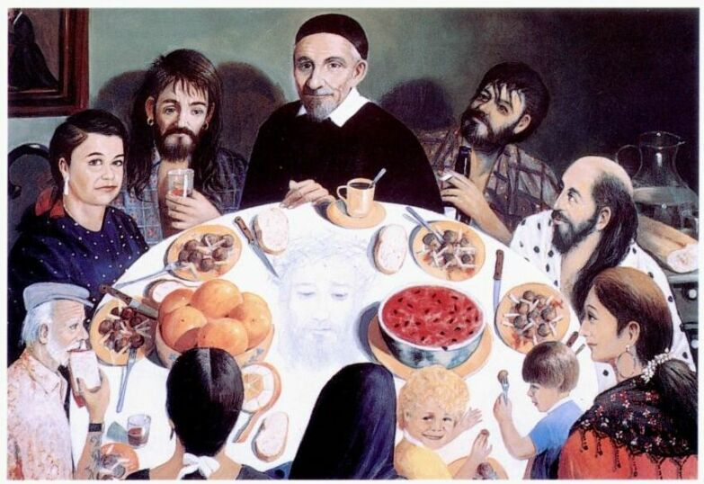
For Vincent, it is the simple who have what he calls
"true religion."
And they instinctively recognize those with false religion!

Slide 18
What are my motives for serving the needy?
Those good feelings that come from giving?
A reward for me in the next life?
The power difference between me and the receiver?
All of these could diminish and do not build up the self-esteem of the one served!

Slide 19
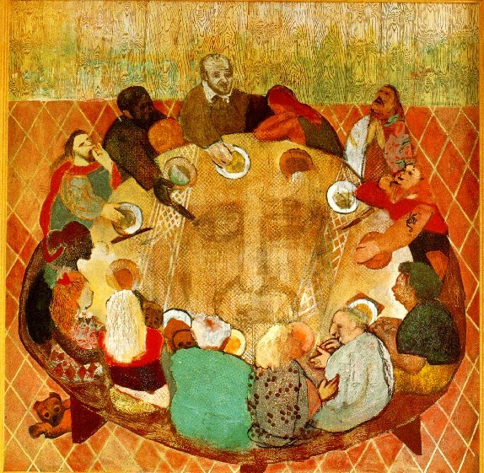
For charity to be healing, only one motive is needed: genuine love and respect for the person receiving it.
St. Vincent's special knack was to honor
the ones he helped in the very act of helping them. As one writer put it, "the poor could forgive him the bread he gave them." When he gave assistance, the people believed his charity came from real respect for them.

Slide 20
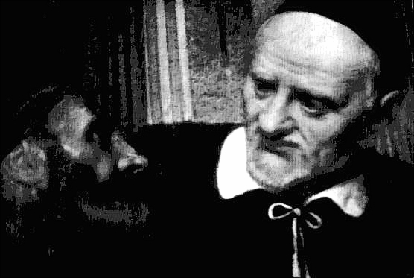
St. Vincent elicited a trusting reaction from others.
His claims were solid.
His promises and explanations "rang true".

Slide 21
St. Vincent speaks against the massive manipulation-- and cheapening-- of the bond between image and imaged.
He invites us to a demanding, countercultural practice:
the discipline of Gospel genuineness.

Slide 22
Source: based on “Vincentian Simplicity: A Core Leadership Trait” by Thomas McKenna C.M., S.T.D.
http://via.library.depaul.edu/cgi/viewcontent.cgi?article=1259&context=vhj

