Slide 1
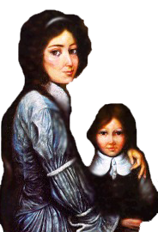
St. Elizabeth ANN SETON
Sowing seeds for eternity

Slide 2
Elizabeth communicated her faith-filled philosophy to faculty, pupils, and parents in all her contacts. She inspired her pupils to consider the attributes of God as father and friend, not as a harsh and demanding judge.

Slide 3
If a painter should draw his lines without proposing any idea to himself, his work would be a blot; or should a sculptor give a number of strokes to his block without intention to shape it, what would he do but weary himself to no purpose,
while the least of our actions may carry its grace with it, if we turn it right.
Every good action is a grain of seed for eternal life.
(as cited in Provincial Annals, 1809-1820, p. 315)

Slide 4
Elizabeth emphasized the importance of purity of heart and modesty for the girls whom the Sisters of Charity taught. Regarding dress, Elizabeth believed that “simplicity should be your only rule. It makes a lovely woman more lovely”.

Slide 5
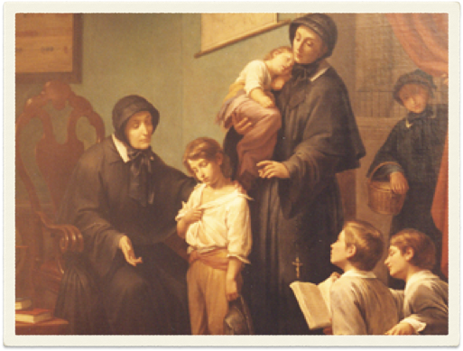
The Sisters of Charity schools were founded on the enduring values of respect and equality. Elizabeth shunned the prejudices of her day. She welcomed pupils from diverse backgrounds, accepting them without discrimination.

Slide 6
Elizabeth translated some of the classical documents related to Saint Vincent and Saint Louise in order to teach her sisters about the Vincentian heritage and its values. In the process,
Elizabeth learned how the first Daughters of Charity had instructed poor children. She employed these same principles as foundational elements of education at Saint Joseph's.

Slide 7
Elizabeth created a faith-filled climate of education which was integrated, creative, flexible, excellent, person-oriented, collaborative, and focused.

Slide 8
Source:
Historical Perspectives on Elizabeth Seton and Education: School is My Chief Business
by Betty Ann McNeil, DC

